Slide 1

CSCI E-96 Data Mining, Exploration and Discovery Introduction to Dimensionality Reduction Part 2
Steve Elston
Copyright 2020,2021, 2022, 2023, 2024 Stephen F Elston. All rights reserved.

Slide 2
Lesson Overview
Reduction of high-dimensional spaces to lower-dimensions is widely used in data mining
We have already explored reduction of high dimensional spaces with LSH
Projection methods for high dimensions
Highly efficient alternative to PCA
Bounds on distance error
Manifold learning and visualization in high dimensions
Project to low dimensional manifold
May preserve distance
Association models – next week

Slide 3
Introduction to Dimensionality Reduction
Why is dimensionality reduction possible?
Consider the information content of each feature
Information of a feature is only unique if it is independent of all other features
Dependent features have redundant information
Dimensionality can be reduced if features are dependent
Almost always the case in real-world data
Linear dependency
Nonlinear dependency
Dependency implies effective dimensionality less than number of features

Slide 4
Introduction to Dimensionality Reduction
Dimensionality reduction is widely used in data mining
Human understanding of high dimensional spaces is difficult at best
For most people, perception of data relationships starts to diminish beyond 4 dimensions
Exploration of complex spaces can be aided by projection into lower dimensional space
Most algorithms converge better in lower dimensional spaces
High dimensional spaces can lead to over-fitting of data mining algorithms
For example, clustering in high dimensional spaces can lead fragmentation of the data
Dimensionality reduction can improve results

Slide 5
Clustering in High Dimensions and The Curse of Dimensionality!

Slide 6
What Could Possibly Go Wrong? Curse of Dimensionality!
Cluster models scale poorly with dimensionality
Consider sampling required to maintain the same uniformly distributed density in a hypercube:
An example of the Curse of Dimensionality!
Dimensions | Samples
1 | 10
2 | 100
3 | 1,000
5 | 10⁵
10 | 10¹⁰

Slide 7
What Could Possibly Go Wrong? Curse of Dimensionality
The curse of dimensionality means that all clusters are the same in high dimensions
Sampling density decreases exponentially
Distances converge to the same size in a high dimensional space
The choice of metric does not help
All distances are the same in high dimensions!
Implication is that high-dimensional cluster models are easy to overfit!!

Slide 8
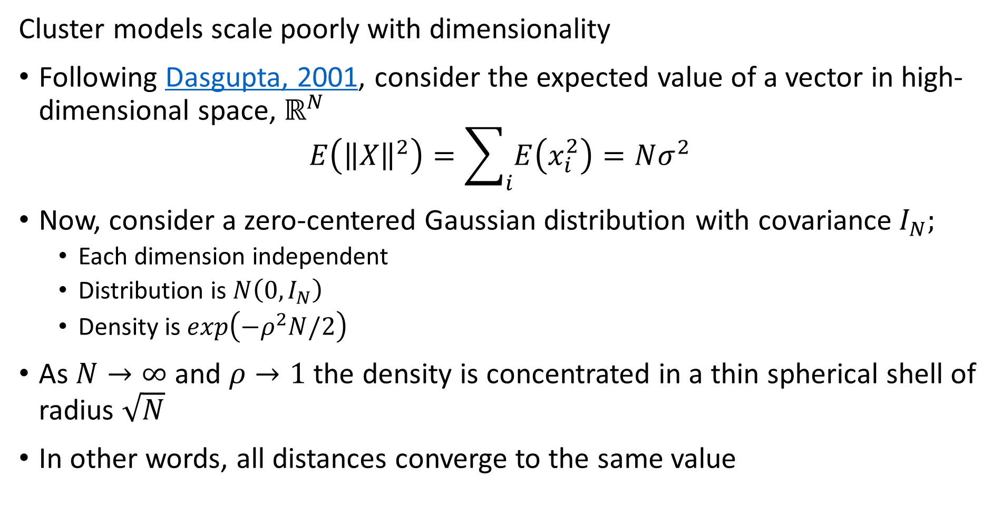
What Could Possibly Go Wrong? Curse of Dimensionality
Cluster models scale poorly with dimensionality
Following Dasgupta, 2001, consider the expected value of a vector in high-dimensional space, $ℝ^{N}$
$$E\left({\left\|X\right\|}^{2}\right)=\sum_{i}{E\left(x_{i}^{2}\right)=Nσ^{2}}$$
Now, consider a zero-centered Gaussian distribution with covariance $I_{N};$
Each dimension independent
Distribution is$N\left(0,I_{N}\right)$
Density is $exp\left(−ρ^{2}N/2\right)$
As $N→∞$ and $ρ→1$ the density is concentrated in a thin spherical shell of radius $\sqrt{N}$
In other words, all distances converge to the same value

Slide 9
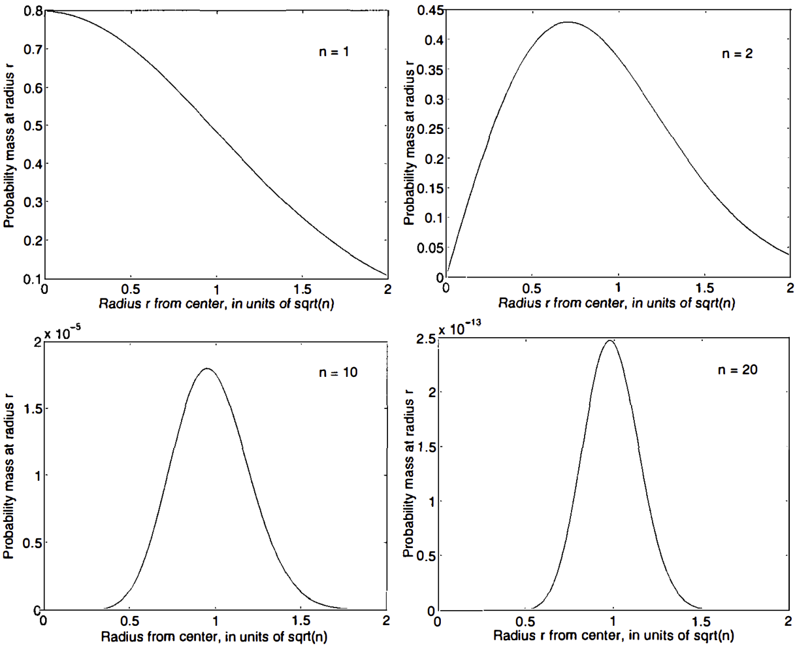
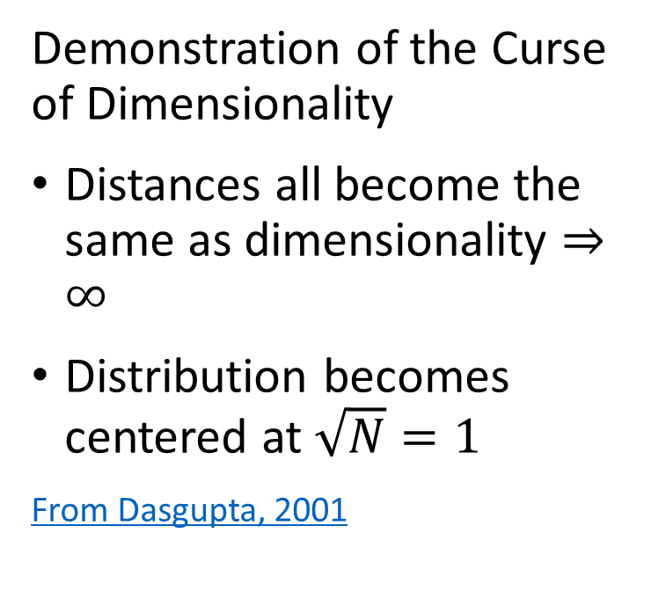
What Could Possibly Go Wrong? Curse of Dimensionality
Demonstration of the Curse of Dimensionality
Distances all become the same as dimensionality $⇒∞$
Distribution becomes centered at $\sqrt{N}=1$
From Dasgupta, 2001

Slide 10
What Could Possibly Go Wrong? Curse of Dimensionality
How can we extend clustering to higher dimensions?
Reducing dimensionality can help
Need to create a lower dimensional embedding
But how?
PCA is a linear projection
Several families of alternatives
Subspace clustering
Random projection
Manifold learning

Slide 11
What Could Possibly Go Wrong? Curse of Dimensionality
How can we extend clustering to higher dimensions?
Reducing dimensionality can help
Need to create a lower dimensional embedding
But how?
Subspace clustering samples many subspaces to find embedding
Limited scalability since there are infinite possible subspaces
Heuristic, downward closure property, improves scalability - addressed in a subsequent lesson
Python subspace clustering package in Chong You’s GitHub repository

Slide 12
What Could Possibly Go Wrong? Curse of Dimensionality
How can we extend clustering to higher dimensions?
Reducing dimensionality can help
Need to create a lower dimensional embedding
But how?
Random projection methods used randomized sampling to find an approximate embedding space
Trade-off between error and lower dimensions governed by the Johnson-Lindenstrauss lemma
Error increases as dimensionality of embedding space decreases
Well supported in Scikit Learn

Slide 13
What Could Possibly Go Wrong? Curse of Dimensionality
How can we extend clustering to higher dimensions?
Reducing dimensionality can help
Need to create a lower dimensional embedding
But how?
Manifold Learning finds projection of high-dimensional space onto a low-dimensional manifold
Many commonly used unsupervised methods
Spectral embedding
UMAP
t-distributed Stochastic Neighbor Embedding (t-SNE)
…..
Well supported in Python packages

Slide 14
Projection Methods

Slide 15
Random Projection Methods
How can we overcome the curse of dimensionality?
Random projection methods sample random directions
Introduced in several contexts, including by Bingham and Mannila, 2001 and Achliptas, 2001
Alternative to PCA for very high dimensional spaces
Error of the random projection to lower dimensional space is bounded
Distance is therefore preserved
Random projections in Euclidean space tend to create spherical clusters
Spherical clusters are easier for many algorithms to deal with

Slide 16
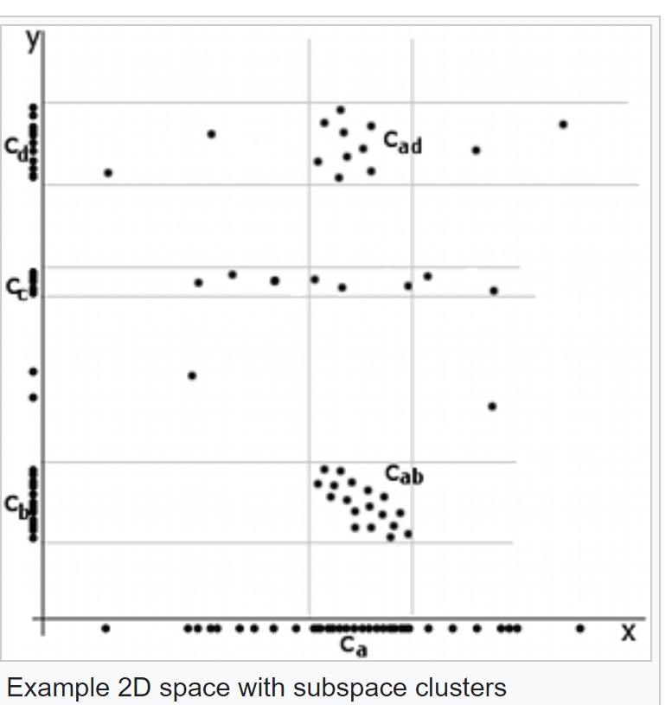
Random Projection Methods
Example of difficult dimensionality reduction
Cluster centers aligned along x axis
Apparent cluster along y axis
No apparent cluster along x axis
Credit Wikipedia commons

Slide 17
Random Projection Methods
Example of difficult dimensionality reduction
Highest variance direction aligned with axis
Largest eigenvector for largest eigenvalue along axes
Principal components same as axes
No dimensionality reduction
First Principal Component
Credit Wikipedia commons
Second Principle Component

Slide 18
Random Projection Methods
Example of difficult dimensionality reduction
Cluster models will struggle
2 well defined clusters on both components
Cluster with low variance on first component, dispersed along second component
- Not a spherical cluster!
First Principal Component
Credit Wikipedia commons
Second Principle Component

Slide 19
Subspace Projection Methods
How can we extend clustering to higher dimensions?
Subspace clustering samples many subspaces to find embedding
Limited scalability since there are infinite possible subspaces
Heuristic, downward closure property, improves scalability - addressed in a subsequent lesson
Python subspace clustering package in Chong You’s GitHub repository
We will not pursue this method further here
Random projection methods are a better alternative in many cases

Slide 20
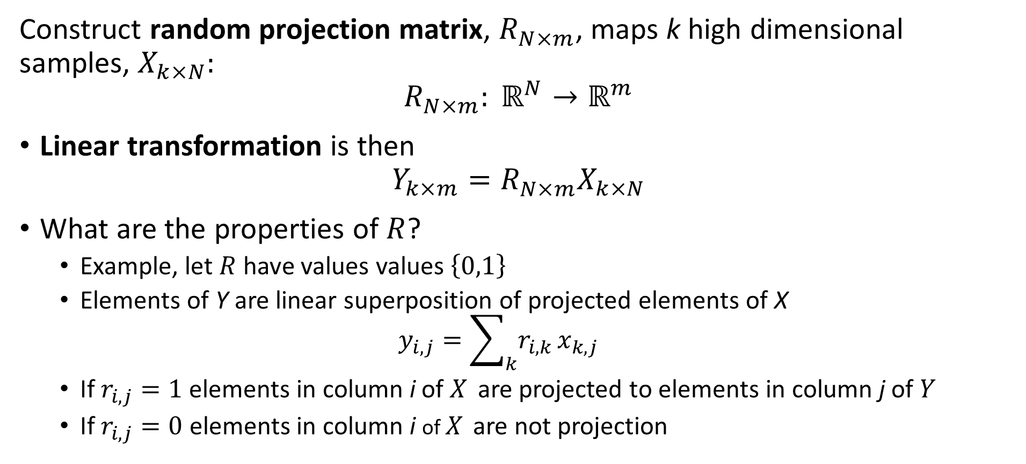
Random Projection Methods
Construct random projection matrix, $R_{N×m}^{ }$, maps k high dimensional samples, $X_{k×N}:$
$${R_{N×m}^{ }: ℝ}^{N}→ℝ^{m}$$
Linear transformation is then
$$Y_{k×m}=R_{N×m}^{ }X_{k×N}$$
What are the properties of $R$?
Example, let $R$ have values values $\left\{0,1\right\}$
Elements of Y are linear superposition of projected elements of X
$$y_{i,j}=\sum_{k}{r_{i,k}}x_{k,j}$$
If $r_{i,j}=1$ elements in column i of $X_{ }$ are projected to elements in column j of $Y$
If $r_{i,j}=0$ elements in column i of $X_{ }$ are not projection

Slide 21
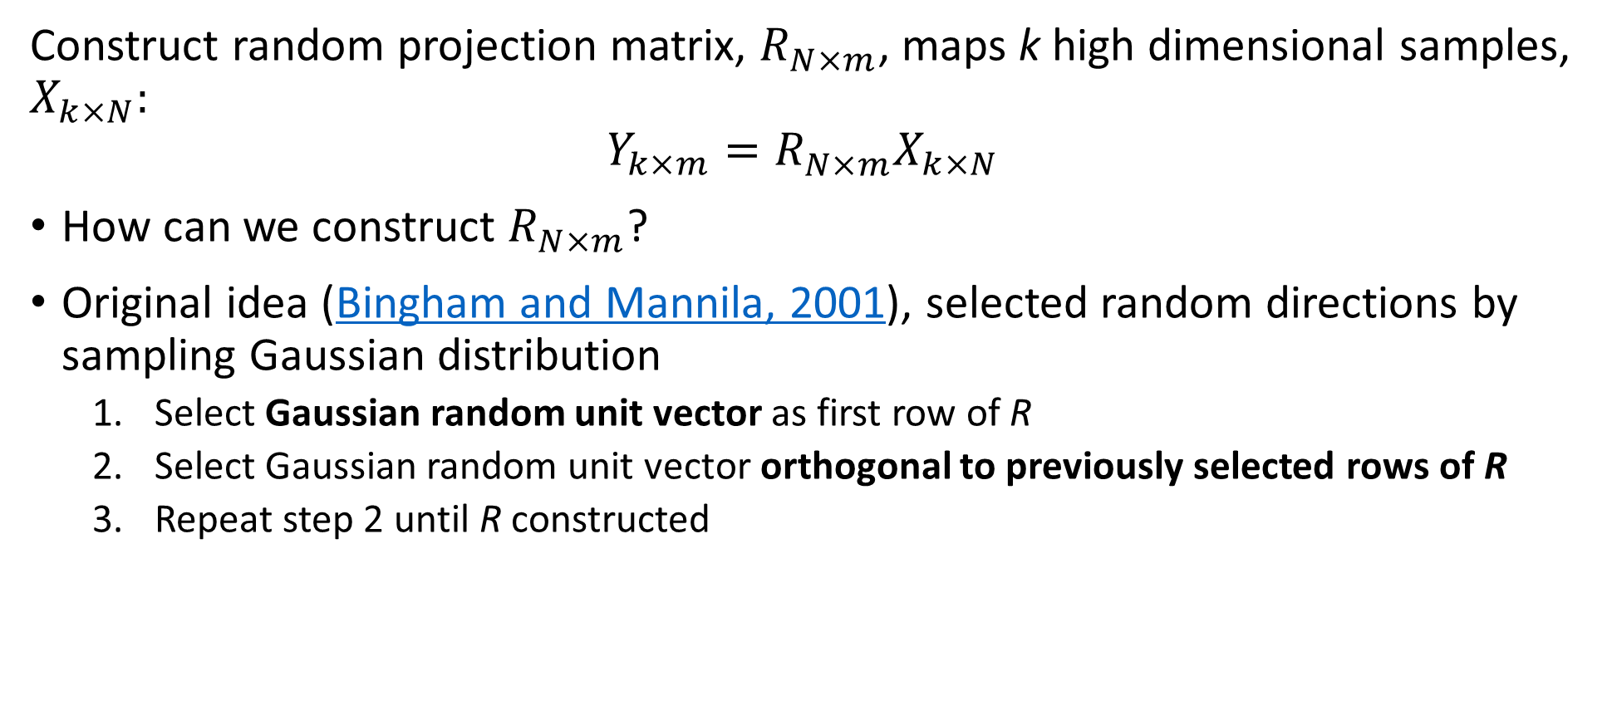
Random Projection Methods
Construct random projection matrix, $R_{N×m}^{ }$, maps k high dimensional samples, $X_{k×N}:$
$$Y_{k×m}=R_{N×m}^{ }X_{k×N}$$
How can we construct $R_{N×m}^{ }$?
Original idea (Bingham and Mannila, 2001), selected random directions by sampling Gaussian distribution
Select Gaussian random unit vector as first row of R
Select Gaussian random unit vector orthogonal to previously selected rows of R
Repeat step 2 until R constructed

Slide 22
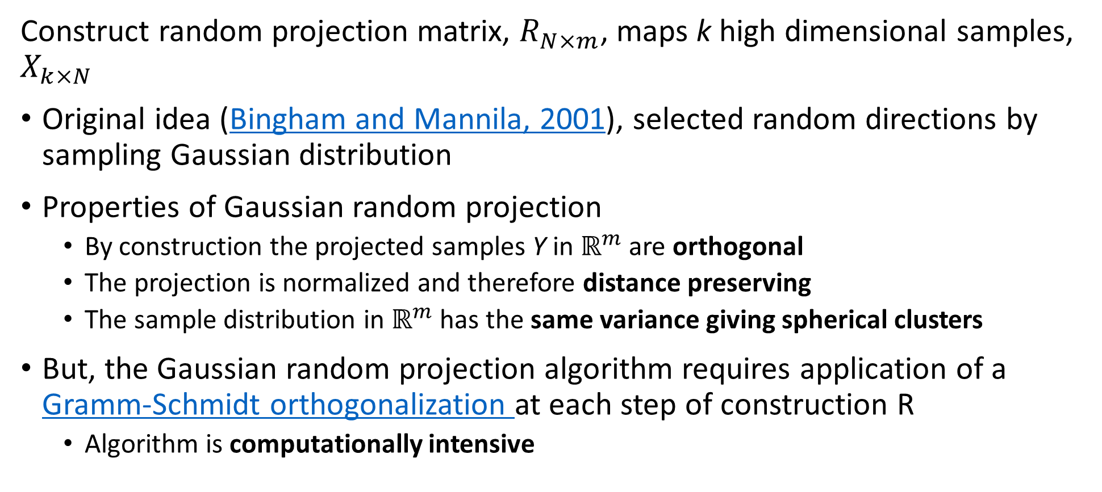
Random Projection Methods
Construct random projection matrix, $R_{N×m}^{ }$, maps k high dimensional samples, $X_{k×N}$
Original idea (Bingham and Mannila, 2001), selected random directions by sampling Gaussian distribution
Properties of Gaussian random projection
By construction the projected samples Y in $ℝ^{m}$ are orthogonal
The projection is normalized and therefore distance preserving
The sample distribution in $ℝ^{m}$ has the same variance giving spherical clusters
But, the Gaussian random projection algorithm requires application of a Gramm-Schmidt orthogonalization at each step of construction R
Algorithm is computationally intensive

Slide 23
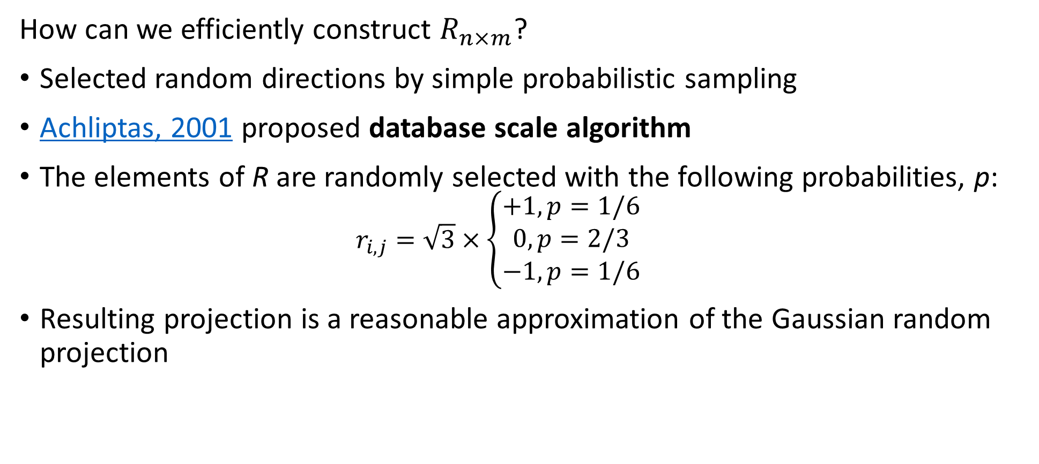
Random Projection Methods
How can we efficiently construct $R_{n×m}^{ }$?
Selected random directions by simple probabilistic sampling
Achliptas, 2001 proposed database scale algorithm
The elements of R are randomly selected with the following probabilities, p:
$$r_{i,j}=\sqrt{3}×\left\{\begin{aligned}+1, p=1/6 \\ 0, p=2/3 \\ −1, p=1/6\end{aligned}\right.$$
Resulting projection is a reasonable approximation of the Gaussian random projection

Slide 24
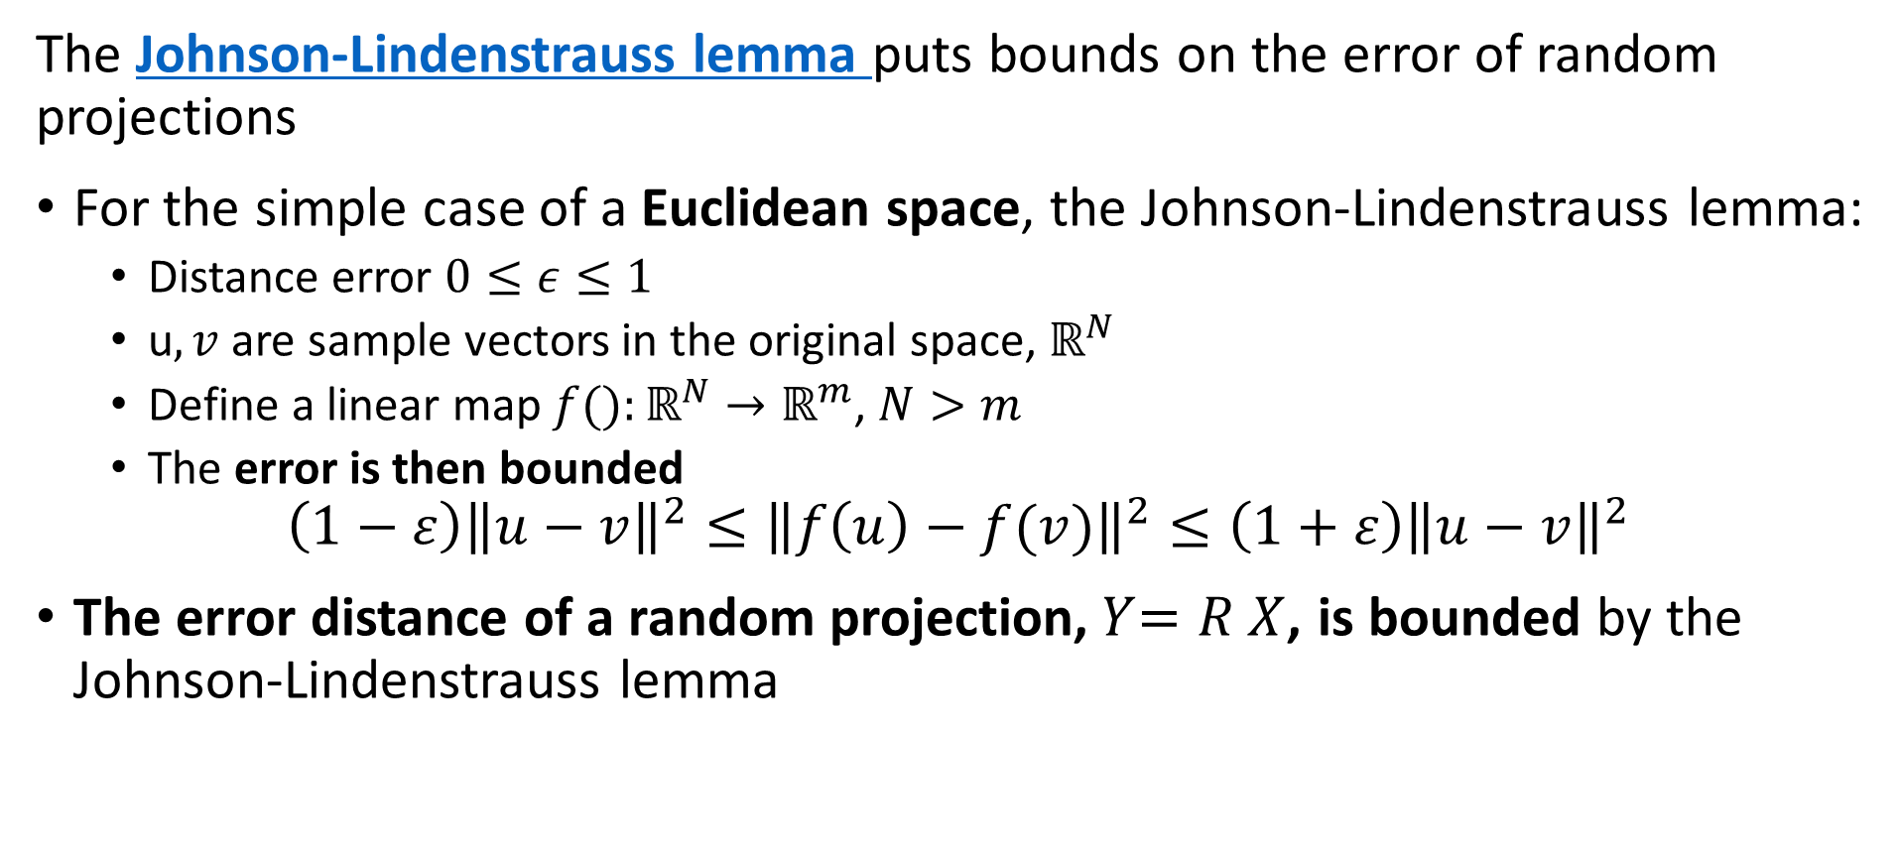
Random Projection Methods
The Johnson-Lindenstrauss lemma puts bounds on the error of random projections
For the simple case of a Euclidean space, the Johnson-Lindenstrauss lemma:
Distance error $0≤ε≤1$
u$,v$ are sample vectors in the original space, $ℝ^{N}$
Define a linear map $f():ℝ^{N}→ℝ^{m}$, $N>m$
The error is then bounded
$$\left(1−ε\right){\left\|u−v\right\|}^{2}≤{\left\|f\left(u\right)−f(v)\right\|}^{2}≤\left(1+ε\right){\left\|u−v\right\|}^{2}$$
The error distance of a random projection,${ Y}_{ }=R_{ }^{ }X$, is bounded by the Johnson-Lindenstrauss lemma

Slide 25
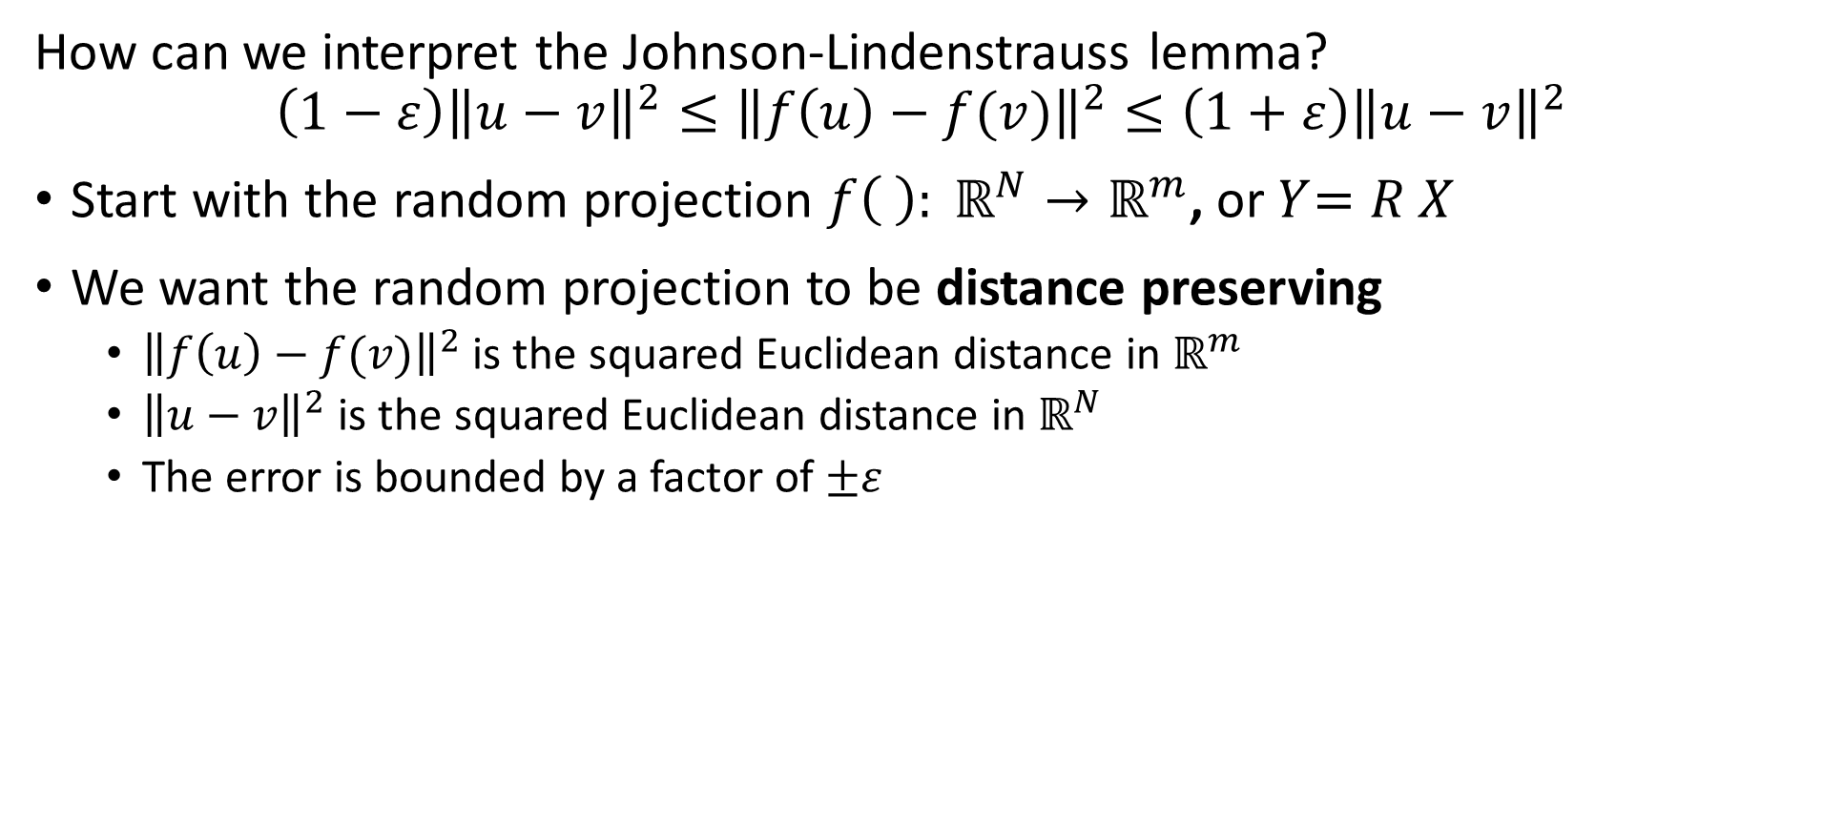
Random Projection Methods
How can we interpret the Johnson-Lindenstrauss lemma?
$$\left(1−ε\right){\left\|u−v\right\|}^{2}≤{\left\|f\left(u\right)−f(v)\right\|}^{2}≤\left(1+ε\right){\left\|u−v\right\|}^{2}$$
Start with the random projection ${f\left( \right): ℝ}^{N}→ℝ^{m}$, or${ Y}_{ }=R_{ }^{ }X$
We want the random projection to be distance preserving
${\left\|f\left(u\right)−f(v)\right\|}^{2}$ is the squared Euclidean distance in $ℝ^{m}$
${\left\|u−v\right\|}^{2}$ is the squared Euclidean distance in $ℝ^{N}$
The error is bounded by a factor of $±ε$

Slide 26
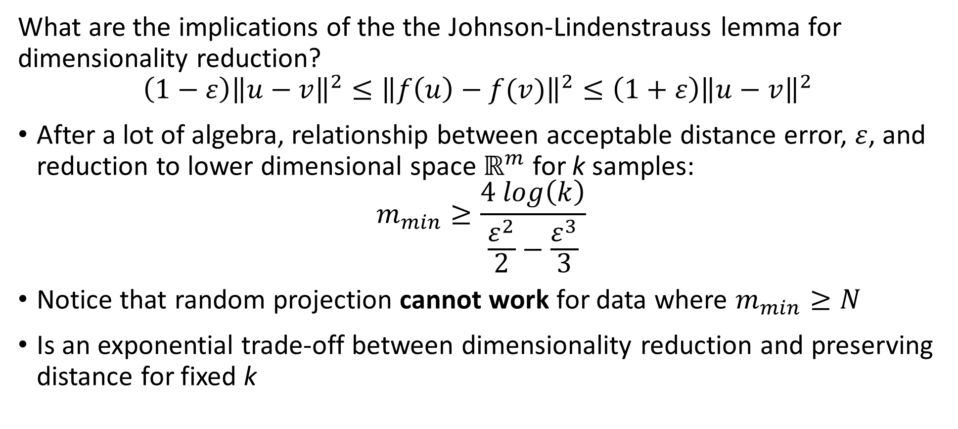
Random Projection Methods
What are the implications of the the Johnson-Lindenstrauss lemma for dimensionality reduction?
$$\left(1−ε\right){\left\|u−v\right\|}^{2}≤{\left\|f\left(u\right)−f(v)\right\|}^{2}≤\left(1+ε\right){\left\|u−v\right\|}^{2}$$
After a lot of algebra, relationship between acceptable distance error, $ε$, and reduction to lower dimensional space $ℝ^{m}$ for k samples:
$$m_{min}≥\frac{4 log\left(k\right)}{\frac{ε^{2}}{2}−\frac{ε^{3}}{3}}$$
Notice that random projection cannot work for data where $m_{min}≥N$
Is an exponential trade-off between dimensionality reduction and preserving distance for fixed k

Slide 27
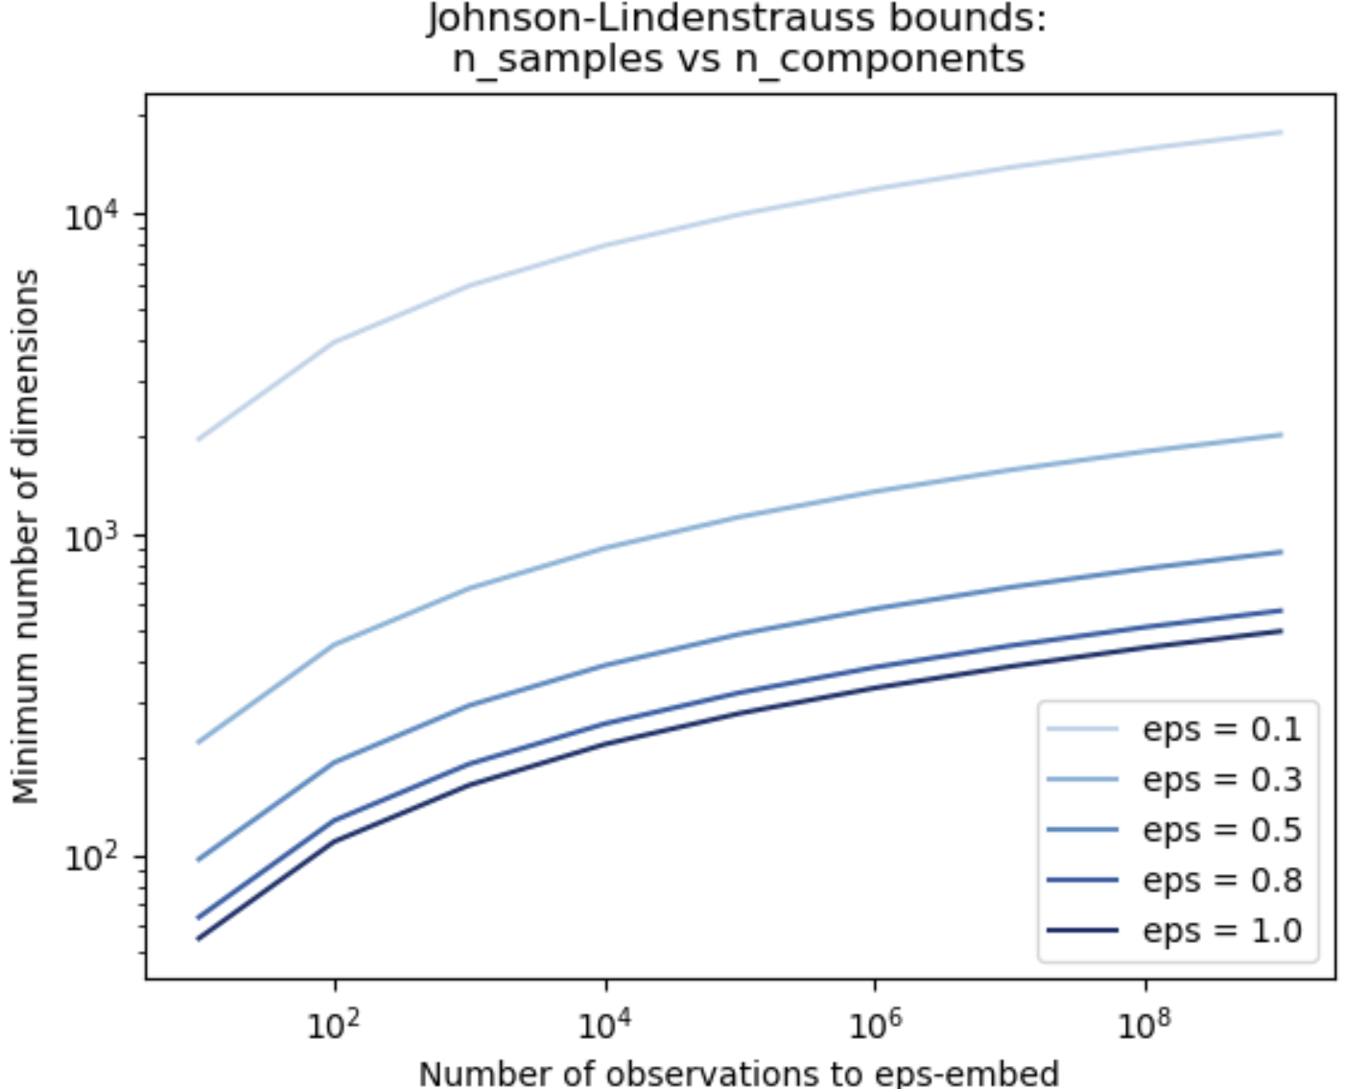
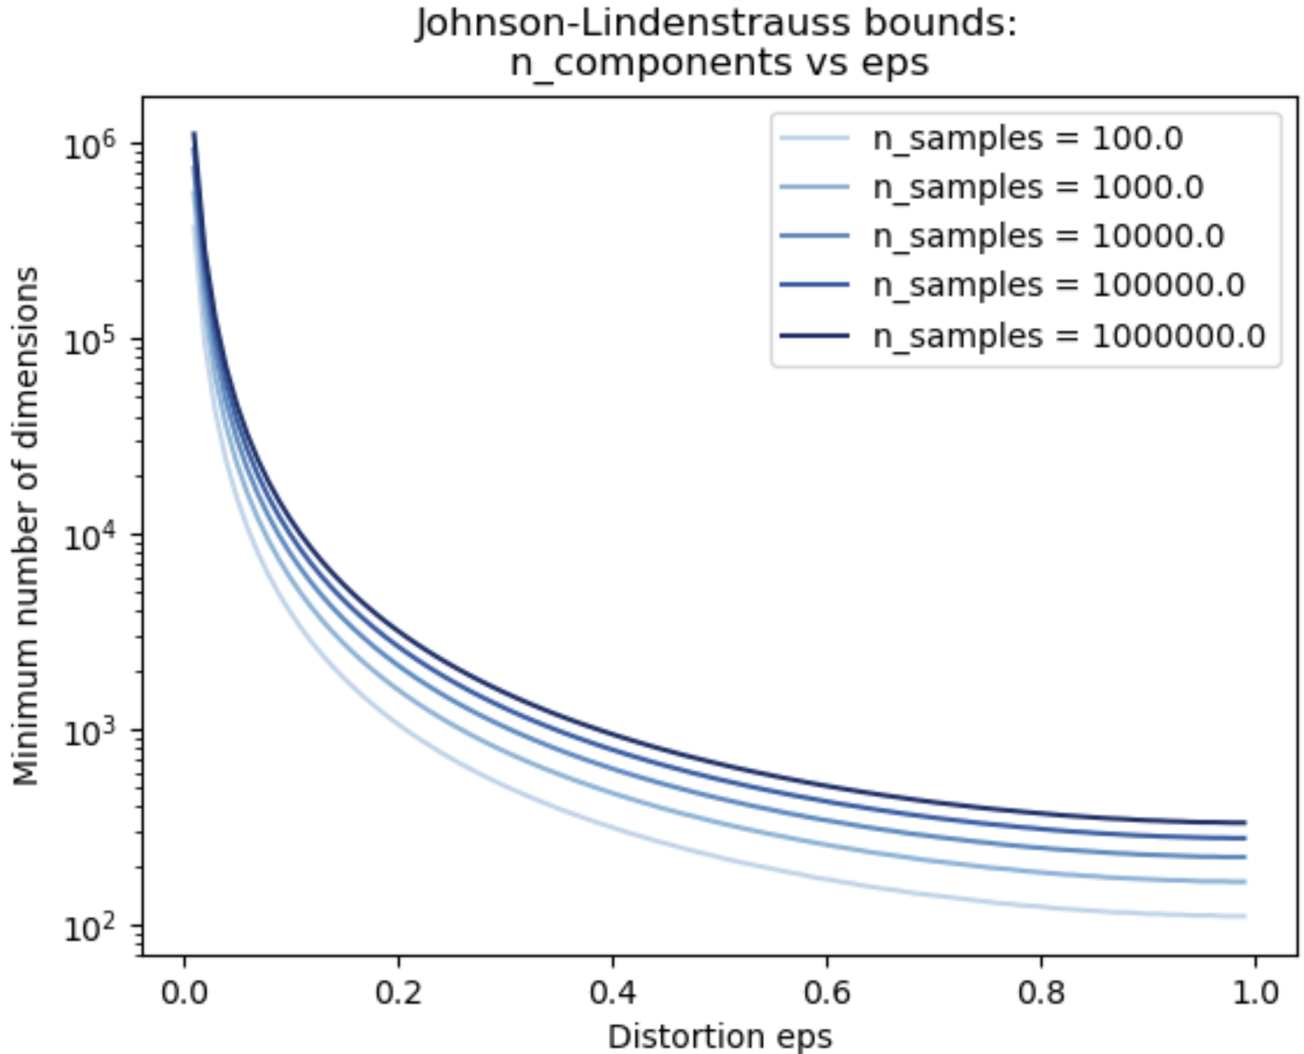
Random Projection Methods
Exponential trade-off between dimensionality reduction and preserving distance
Credit: Scikit-Learn team

Slide 28
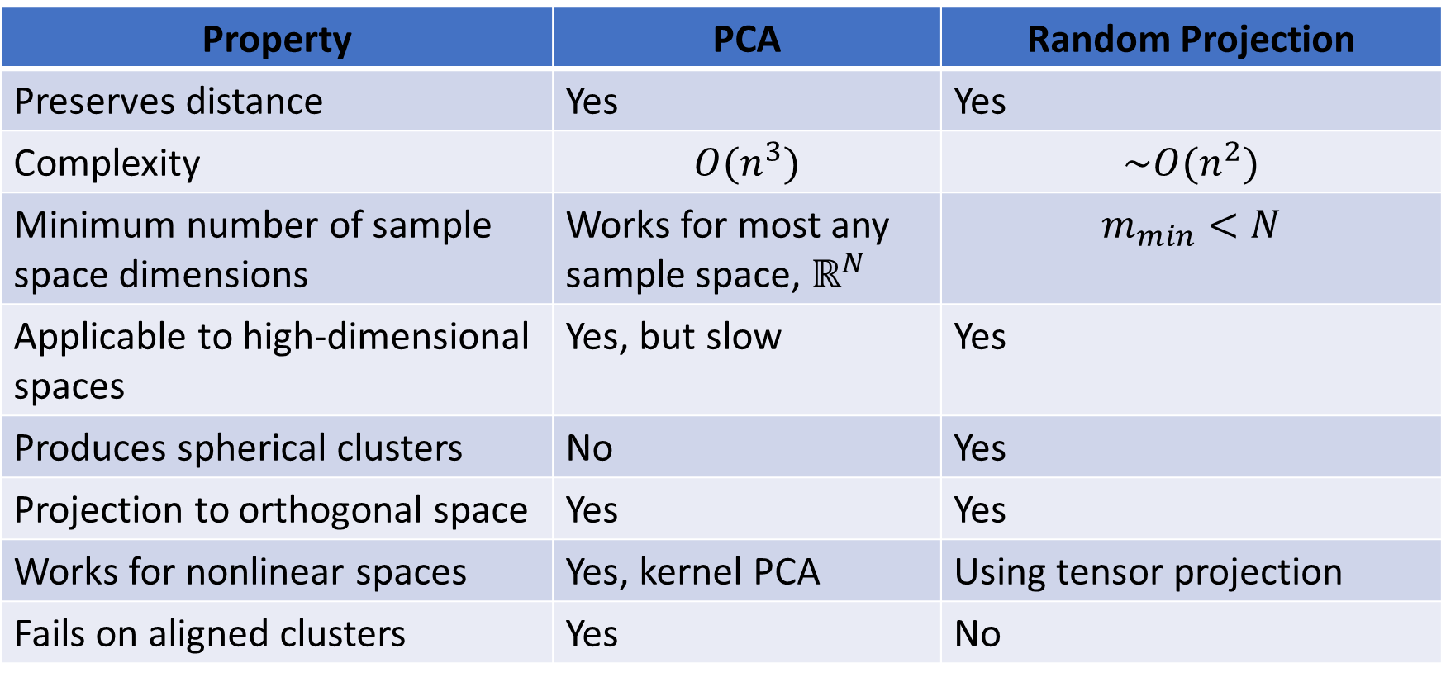
Random Projection Methods
How does random projection compare to PCA?
Property | PCA | Random Projection
Preserves distance | Yes | Yes
Complexity | $$O(n^{3})$$ | $$\sim O(n^{2})$$
Minimum number of sample space dimensions | Works for most any sample space, $ℝ^{N}$ | $$m_{min}<N$$
Applicable to high-dimensional spaces | Yes, but slow | Yes
Produces spherical clusters | No | Yes
Projection to orthogonal space | Yes | Yes
Works for nonlinear spaces | Yes, kernel PCA | Using tensor projection
Fails on aligned clusters | Yes | No

Slide 29
Manifold Learning

Slide 30
Manifold Learning
How can we visualize data from higher dimensions?
Reducing dimensionality can help
Need to create a lower dimensional embedding
But how?
Manifold Learning finds projection of high-dimensional space onto a low-dimensional manifold
Many commonly used unsupervised methods
Spectral embedding
UMAP
t-distributed Stochastic Neighbor Embedding (t-SNE)
…..

Slide 31
Manifold Learning
Map high-dimensional space to a low dimensional manifold
A manifold is a low dimensional surface in a high-dimensional space
Linear manifold is a hyperplane
Nonlinear manifolds for more complex embeddings
Often used as a visualization technique
Human perception generally fails beyond a few dimensions
Mapping to a manifold creates low-dimensional projection of complex data relationships

Slide 32
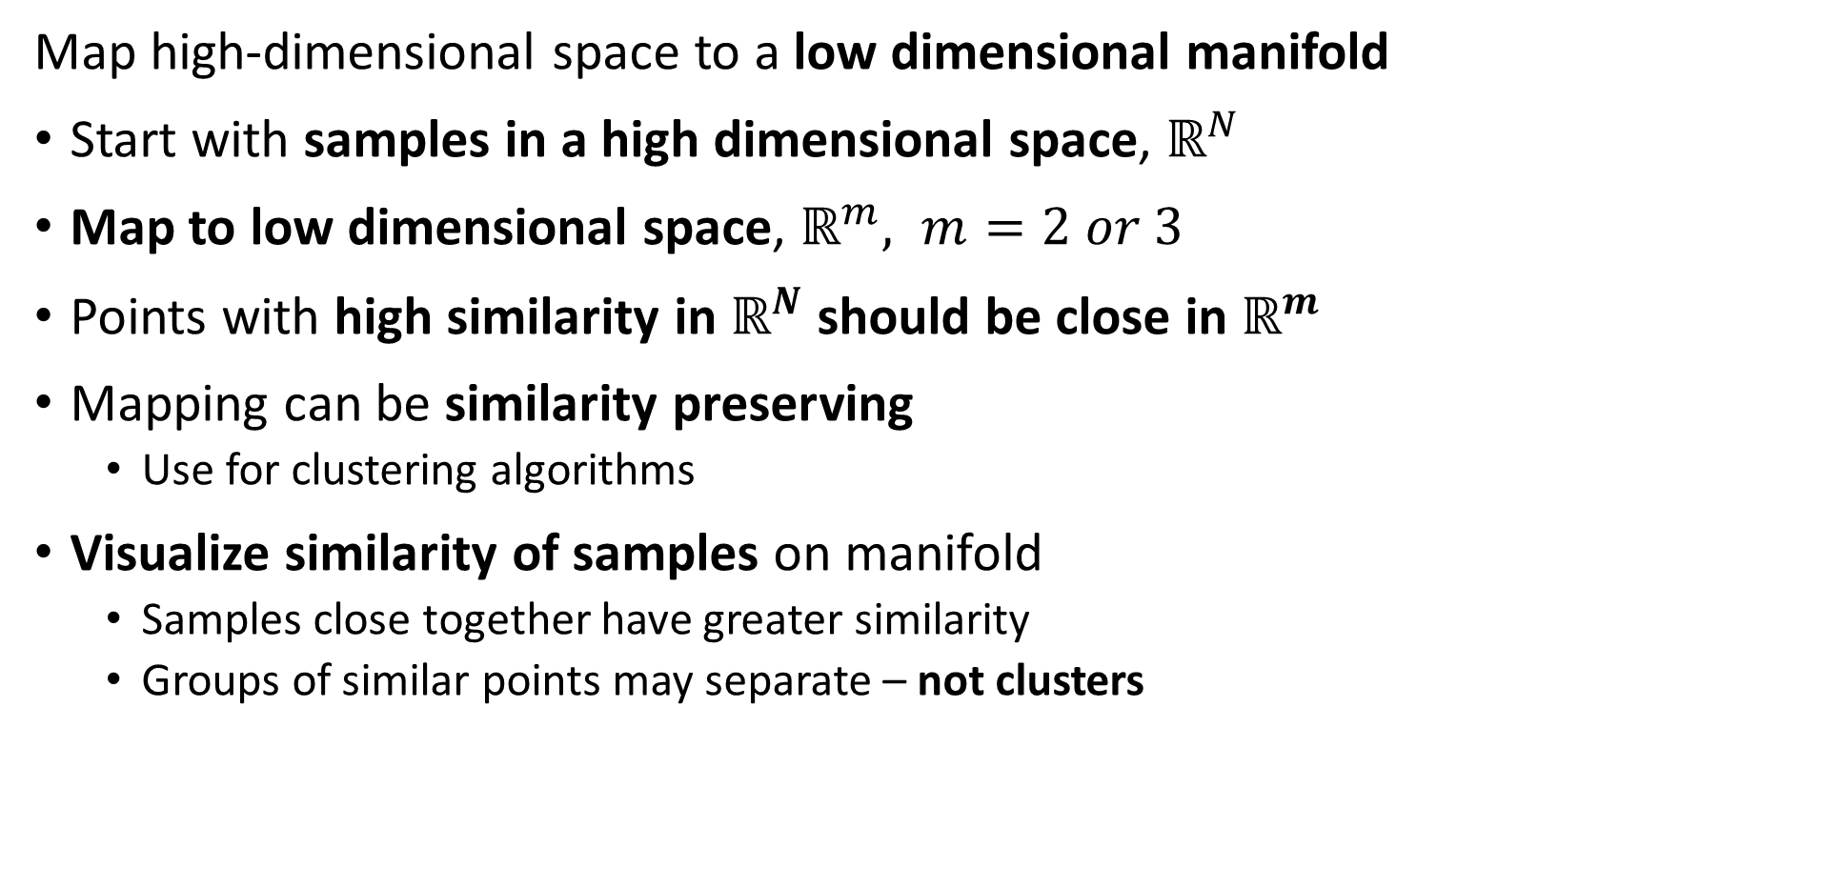
Manifold Learning
Map high-dimensional space to a low dimensional manifold
Start with samples in a high dimensional space, $ℝ^{N}$
Map to low dimensional space, $ℝ^{m}, m=2 or 3$
Points with high similarity in $ℝ^{N}$ should be close in $ℝ^{m}$
Mapping can be similarity preserving
Use for clustering algorithms
Visualize similarity of samples on manifold
Samples close together have greater similarity
Groups of similar points may separate – not clusters

Slide 33
Manifold Learning
Map high-dimensional space to a low dimensional manifold
Many algorithms have been developed
Scikit-Learn supports 8 algorithms + PCA
Projection of first 2 or 3 PCs is on a linear manifold or hyperplane
Kernal PCA maps to nonlinear manifold
We will look at two unsupervised algorithms in detail:
Spectral embedding
UMAP

Slide 34
Spectral Embedding

Slide 35
Spectral Embedding
Spectral embedding uses graph-based construction
Creates a low-dimensional map of high dimensional space
Closely related to spectral clustering algorithm
Uses eigendecomposition of graph Laplacian
Maps to nonlinear manifold from high-dimensional space
Preserves distances of most similar pairs on graph
Supported in Scikit-Learn

Slide 36
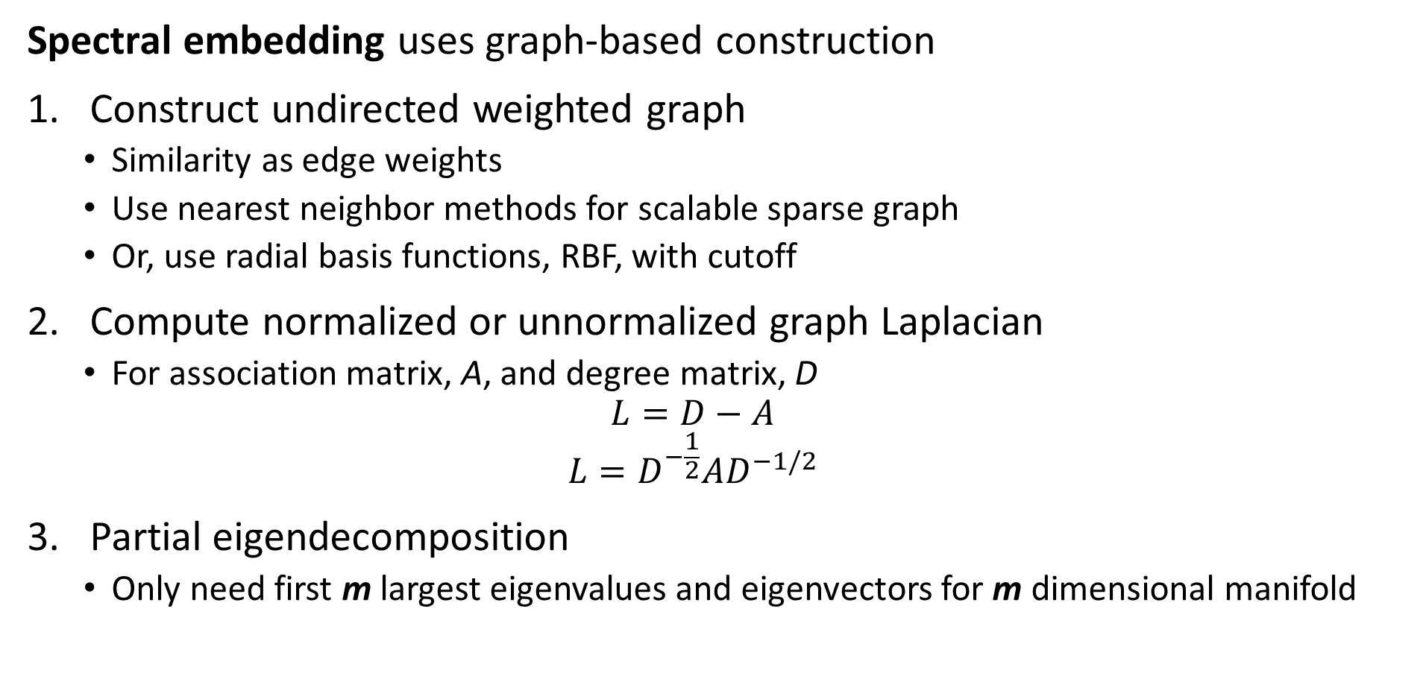
Spectral Embedding
Spectral embedding uses graph-based construction
Construct undirected weighted graph
Similarity as edge weights
Use nearest neighbor methods for scalable sparse graph
Or, use radial basis functions, RBF, with cutoff
Compute normalized or unnormalized graph Laplacian
For association matrix, A, and degree matrix, D
$$L=D−A$$
$$L=D^{−\frac{1}{2}}AD^{−1/2}$$
Partial eigendecomposition
Only need first m largest eigenvalues and eigenvectors for m dimensional manifold

Slide 37
Uniform Manifold Approximation and Projection (UMAP)

Slide 38
Uniform Manifold Approximation and Projection (UMAP)
UMAP maps to a low-dimensional manifold from a nearest neighbor graph
UMAP is (arguably) the state of the art in manifold learning
A generalization of tSNE
Uses topological properties to create graph and map to low-dimensional Euclidian manifold
UMAP attempts to preserve probability distributions and distances
Can be used to reduce dimensions for algorithms like clustering
The UMAP package has Python and R APIs and is very well documented
There are many variations and applications
Read the docs!

Slide 39
Uniform Manifold Approximation and Projection (UMAP)
Key properties of UMAP
UMAP attempts to preserve probability distributions and distances
Assumes the observations on a manifold are locally connected and uniformly distributed
High-dimensional manifold can use most any distance metric
Low-dimensional manifold is Euclidean
Algorithm relies on properties of Reimann manifolds
Reimann manifolds are locally smooth
Reimann manifolds have continuous first derivatives

Slide 40
Uniform Manifold Approximation and Projection (UMAP)
Key properties of UMAP
Low-dimensional Euclidean Reimann manifold has desirable properties
Human perception of visualizations good for Euclidean space
Euclidean space has advantages for machine learning
Wide choice of possible algorithms
Can compute sum of squares
Clusters are elliptical or spherical

Slide 41
Uniform Manifold Approximation and Projection (UMAP)
How does the UMAP algorithm work?
Algorithm for mapping to low dimensional Euclidian space has 4 major steps:
Locally compute fuzzy weights
Search for nearest-neighbors to build graph
Use spectral embedding to find good starting transformation
Minimize cross-entropy to optimize low-dimensional Euclidian manifold

Slide 42
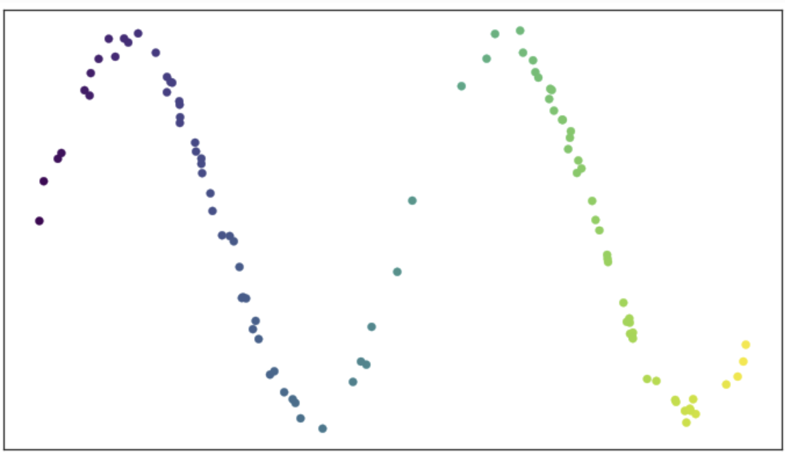
Uniform Manifold Approximation and Projection (UMAP)
How does the UMAP algorithm work?
Consider an example of data on a manifold
Is a two-dimensional space
Sample values are predominantly on a 1-dimensional smooth manifold
How do we construct the low-dimensional manifold?
From UMAP documentation, Leland McInnis, 2018

Slide 43
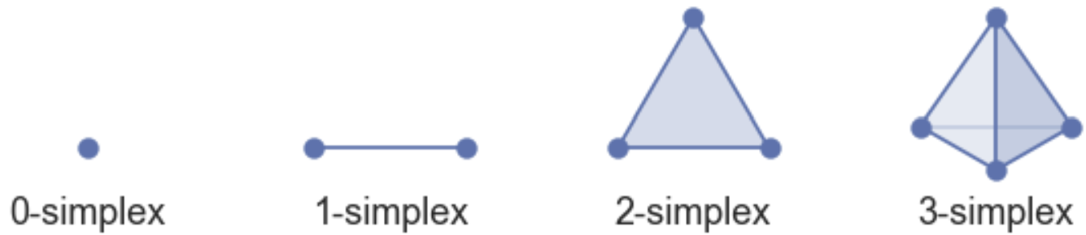
Uniform Manifold Approximation and Projection (UMAP)
How does the UMAP algorithm work?
Construct the manifold as a set of simplexes
K-simplex has k+1 fully connected nodes
Can construct high-dimensional shapes by joining simplexes
Simplexes joined on common faces
Represent complex manifold as simplicial complexes
From UMAP documentation, Leland McInnis, 2018

Slide 44
Uniform Manifold Approximation and Projection (UMAP)
How does the UMAP algorithm work?
Construct the manifold as a set of simplexes – a simplicial complex
Observations are 0-simplexes
Observations are the vertices of higher-dimensional simplexes
0-simplexes are the faces of 1-simplexes
Join 1-simplexes through common vertices to form simplicial complex
For low-dimensional manifold 0 and 1-simplexes are most important

Slide 45
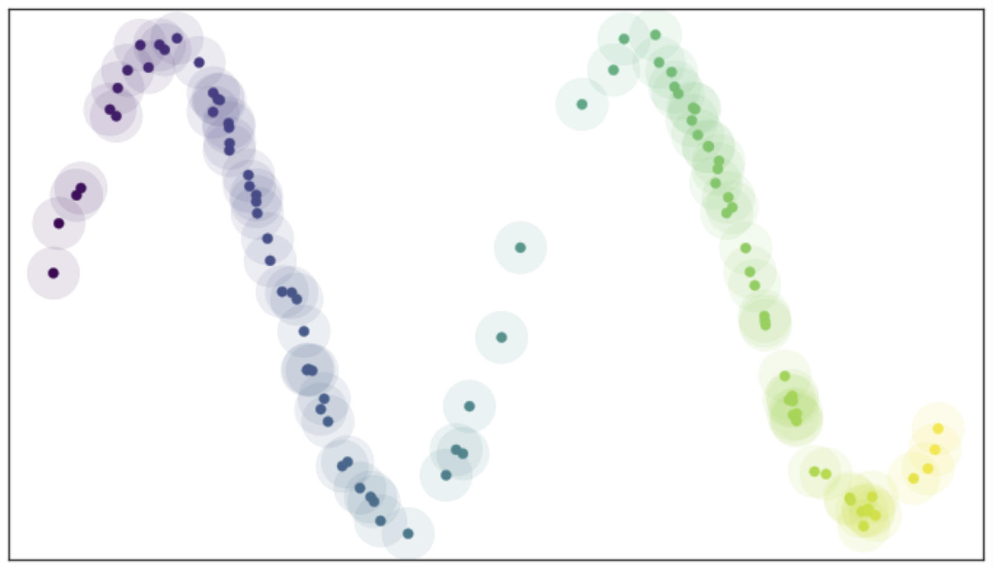
Uniform Manifold Approximation and Projection (UMAP)
How does the UMAP algorithm work?
Find manifold from connectivity of nearest neighbor graph
Place balls (circles in 2-d) of radius r on each point
Nearest neighbors within distance r
Ideal if vertices (observations) uniformly distributed
From UMAP documentation, Leland McInnis, 2018

Slide 46
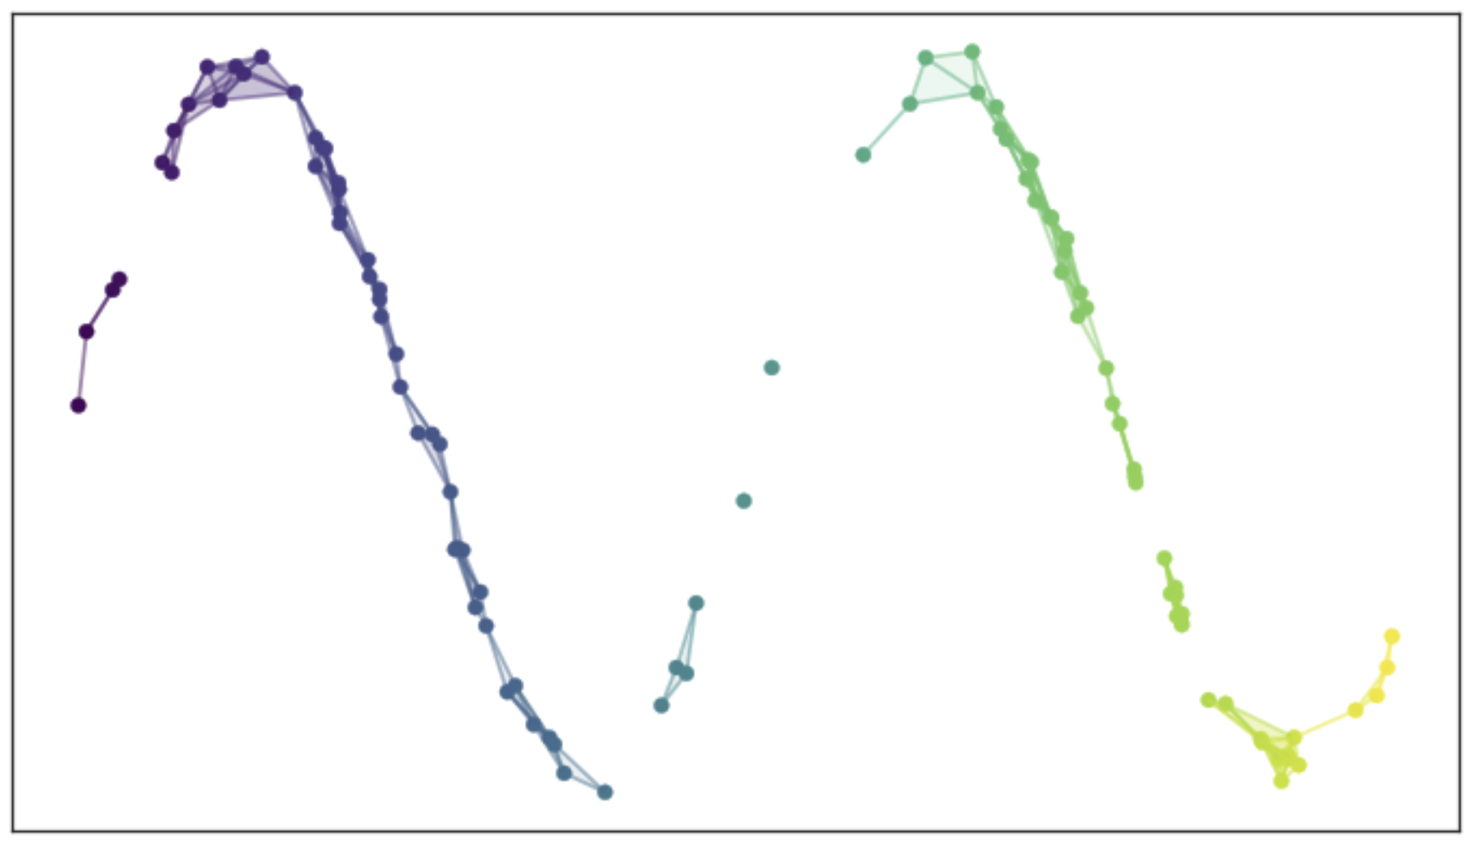
Uniform Manifold Approximation and Projection (UMAP)
How does the UMAP algorithm work?
Edges connect nearest neighbors within distance r
Graph may have disconnected components
The resulting graph is not ideal!
Too dense in some places
Discontinuous in other places
A poor representation of a smooth manifold
From UMAP documentation, Leland McInnis, 2018

Slide 47
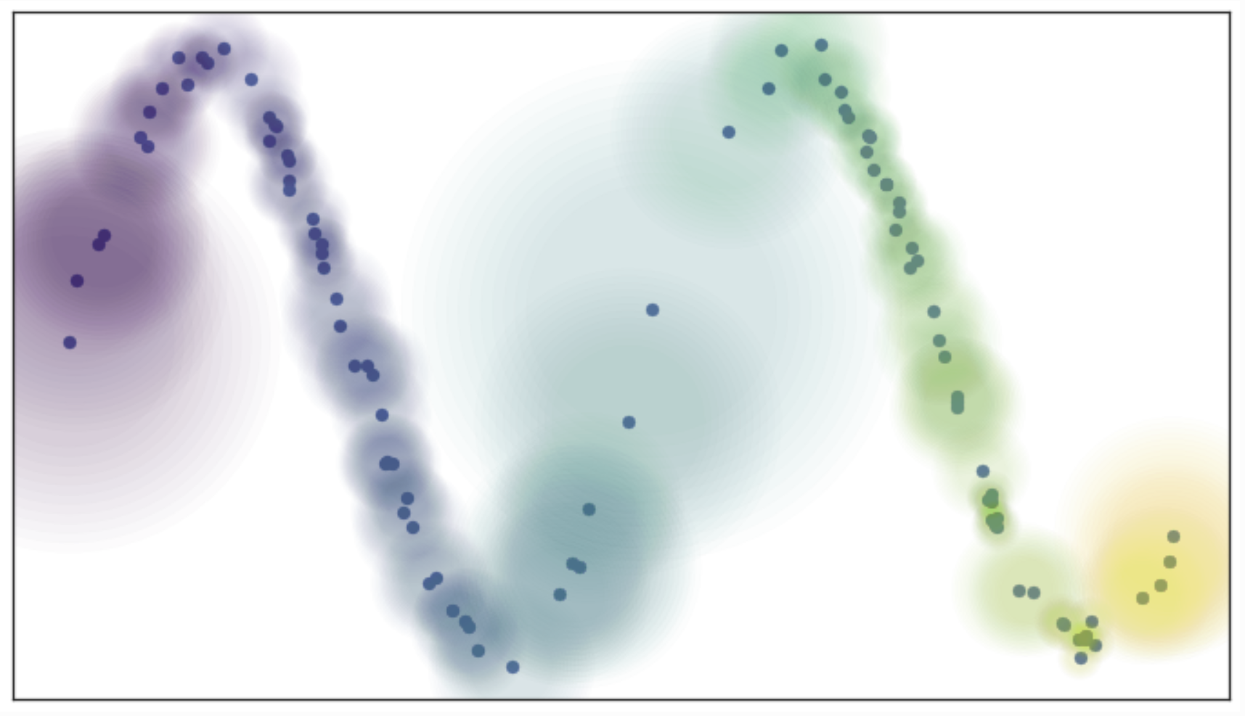
Uniform Manifold Approximation and Projection (UMAP)
How does the UMAP algorithm work?
Use ‘fuzzy balls’ to represent similarity
Example; probability (weight) of connection decays exponentially
Connect vertices on the manifold that are not uniformly distributed
From UMAP documentation, Leland McInnis, 2018

Slide 48
Uniform Manifold Approximation and Projection (UMAP)
How does the UMAP algorithm work?
Size of fuzzy ball determined by local density metric
Works since we assume a Reimann manifold
From UMAP documentation, Leland McInnis, 2018

Slide 49
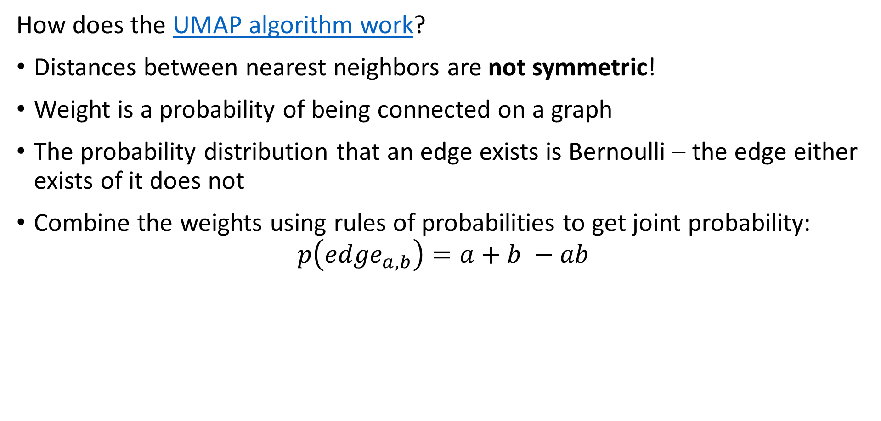
Uniform Manifold Approximation and Projection (UMAP)
How does the UMAP algorithm work?
Distances between nearest neighbors are not symmetric!
Weight is a probability of being connected on a graph
The probability distribution that an edge exists is Bernoulli – the edge either exists of it does not
Combine the weights using rules of probabilities to get joint probability:
$$p\left({edge}_{a,b}\right)=a+b −ab$$

Slide 50
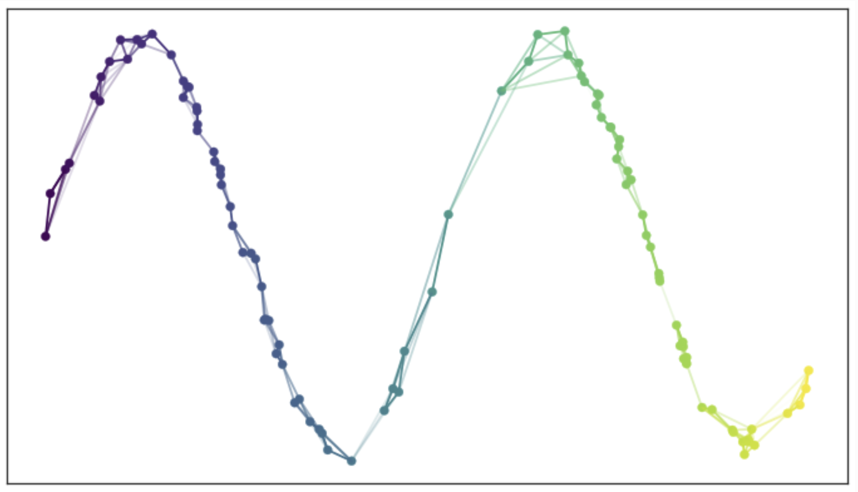
Uniform Manifold Approximation and Projection (UMAP)
How does the UMAP algorithm work?
Use the joint probabilities to define edges
Each observation is now connect to near neighbors
Need to map this graph to a low-dimensional manifold
From UMAP documentation, Leland McInnis, 2018

Slide 51
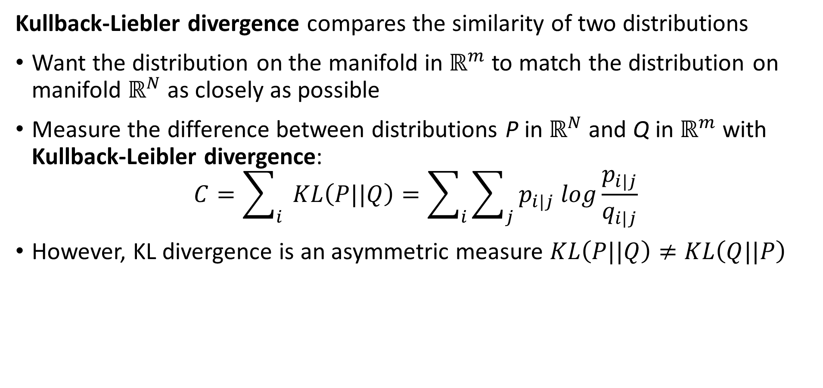
Uniform Manifold Approximation and Projection (UMAP)
Kullback-Liebler divergence compares the similarity of two distributions
Want the distribution on the manifold in $ℝ^{m}$ to match the distribution on manifold $ℝ^{N}$ as closely as possible
Measure the difference between distributions P in $ℝ^{N}$ and Q in $ℝ^{m}$ with Kullback-Leibler divergence:
$$C=\sum_{i}{ }KL\left(P||Q\right)=\sum_{i}{\sum_{j}{p_{i|j} log\frac{p_{i|j}}{q_{i|j}}}}$$
However, KL divergence is an asymmetric measure $KL\left(P||Q\right)≠KL\left(Q||P\right)$

Slide 52
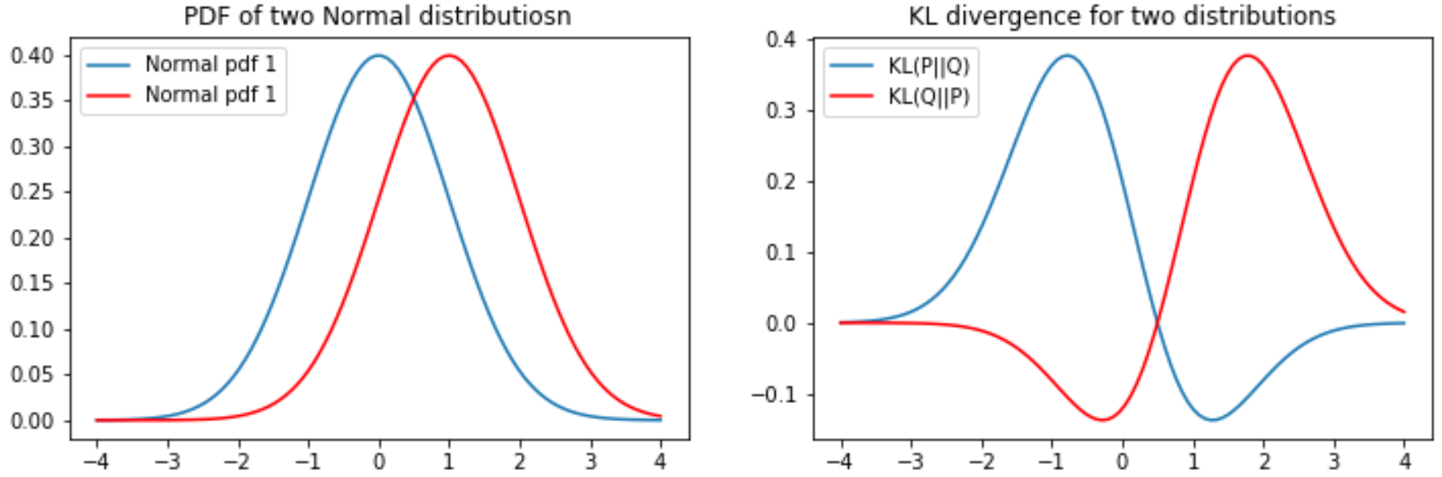
KL Divergence
The KL divergence is asymmetric
For two distributions the KL divergence depend on the order or arguments
Notice that the gradient becomes near zero on one side of the KL function

Slide 53
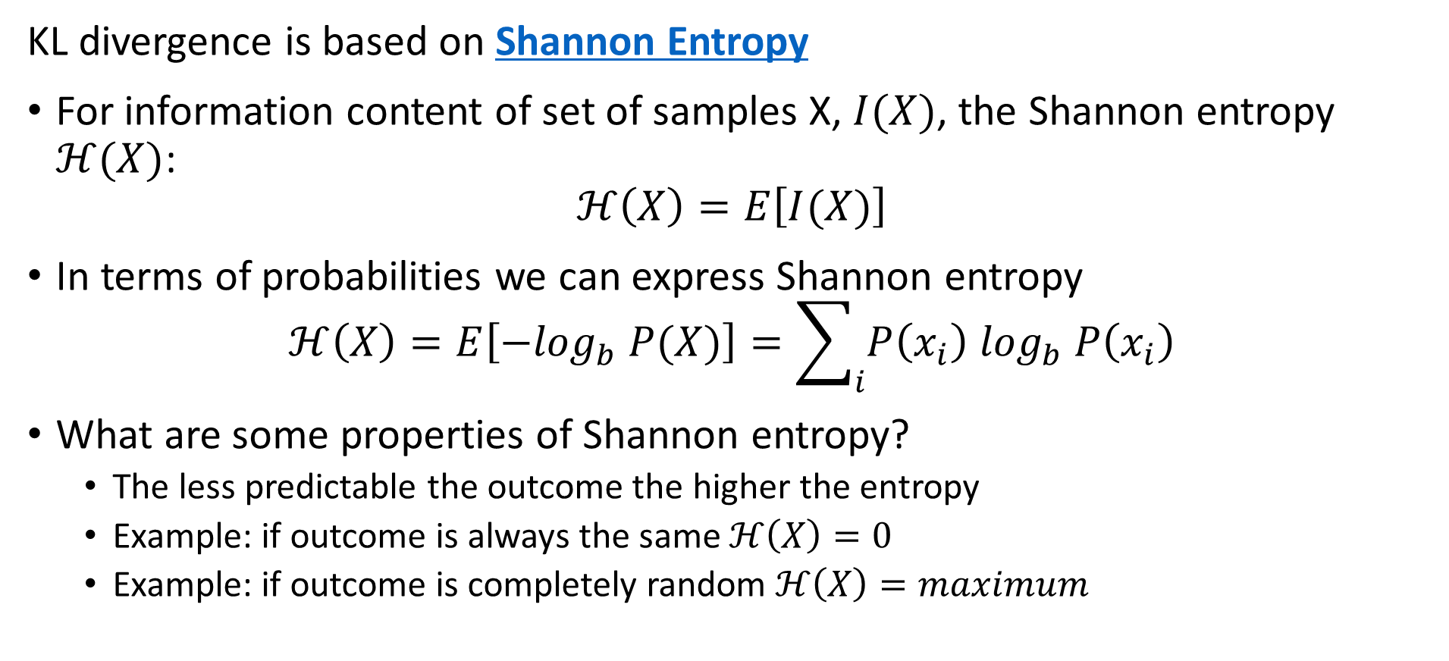
KL Divergence
KL divergence is based on Shannon Entropy
For information content of set of samples X, $I(X)$, the Shannon entropy $ℋ(X)$:
$$ℋ\left(X\right)=E\left[I(X)\right]$$
In terms of probabilities we can express Shannon entropy
$$ℋ\left(X\right)=E\left[{−log}_{b} P(X)\right]=\sum_{i}{P\left(x_{i}\right) \log_{b} P\left(x_{i}\right)}$$
What are some properties of Shannon entropy?
The less predictable the outcome the higher the entropy
Example: if outcome is always the same $ℋ\left(X\right)=0$
Example: if outcome is completely random $ℋ\left(X\right)=maximum$

Slide 54
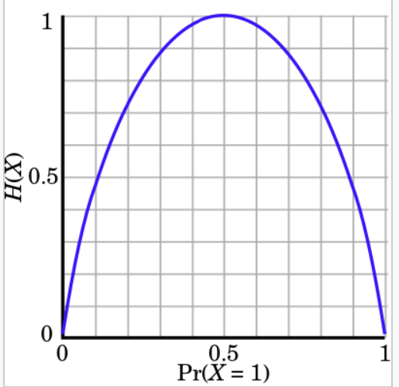
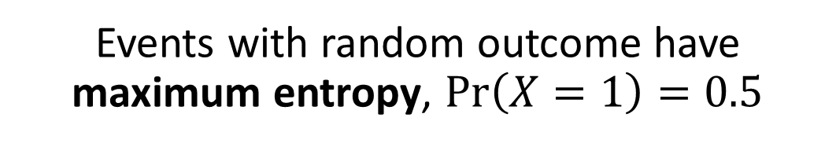
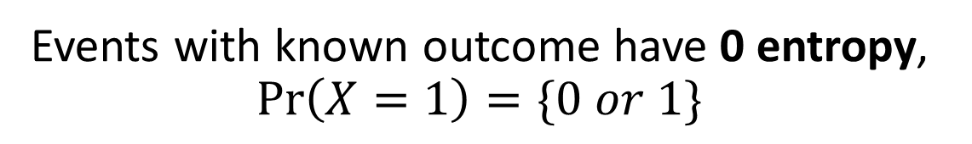
KL Divergence
Events with random outcome have maximum entropy, $\operatorname{Pr}\left(X=1\right)=0.5$
Understanding Shannon Entropy
Example: binomially distributed events
Events with known outcome have 0 entropy, $\operatorname{Pr}\left(X=1\right)=\{0 or 1\}$
Credit: Wikipedia commons

Slide 55
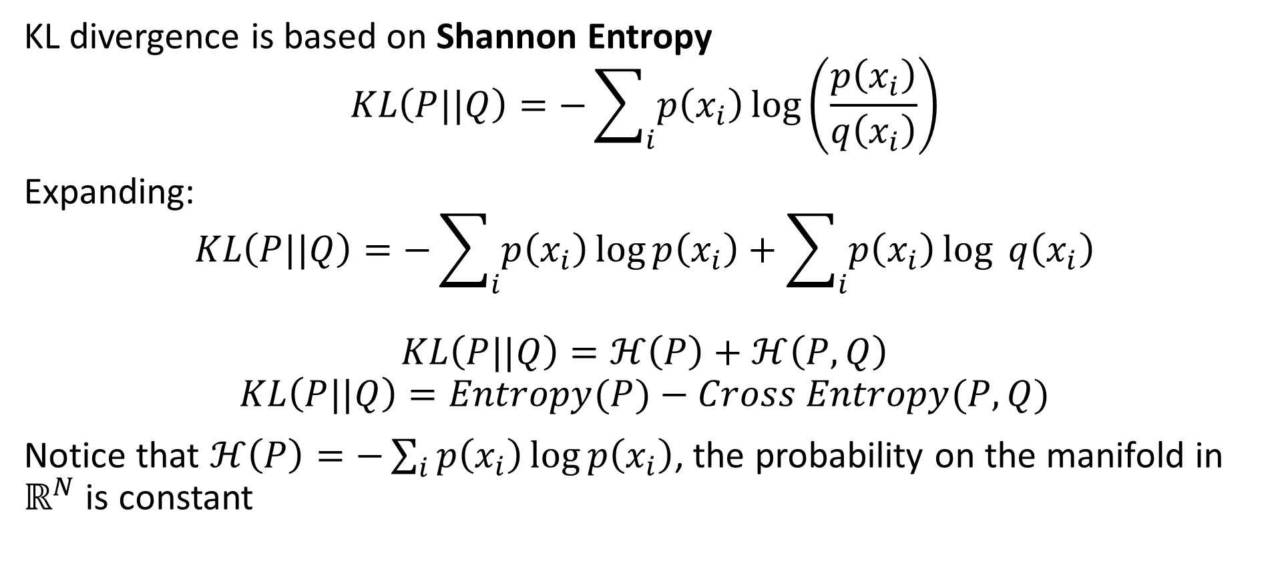
KL Divergence
KL divergence is based on Shannon Entropy
$$KL\left(P||Q\right)=−\sum_{i}{p\left(x_{i}\right)}\log\left(\frac{p\left(x_{i}\right)}{q\left(x_{i}\right)}\right)$$
Expanding:
$$KL\left(P||Q\right)=−\sum_{i}{p\left(x_{i}\right)}\log{p\left(x_{i}\right)}+\sum_{i}{p\left(x_{i}\right)}\log{q\left(x_{i}\right)}$$
$$KL\left(P||Q\right)=ℋ\left(P\right)+ℋ\left(P,Q\right)$$
$$KL\left(P||Q\right)=Entropy(P)−Cross Entropy(P,Q)$$
Notice that $ℋ\left(P\right)=−\sum_{i}{p\left(x_{i}\right)}\log{p\left(x_{i}\right)}$, the probability on the manifold in $ℝ^{N}$ is constant

Slide 56
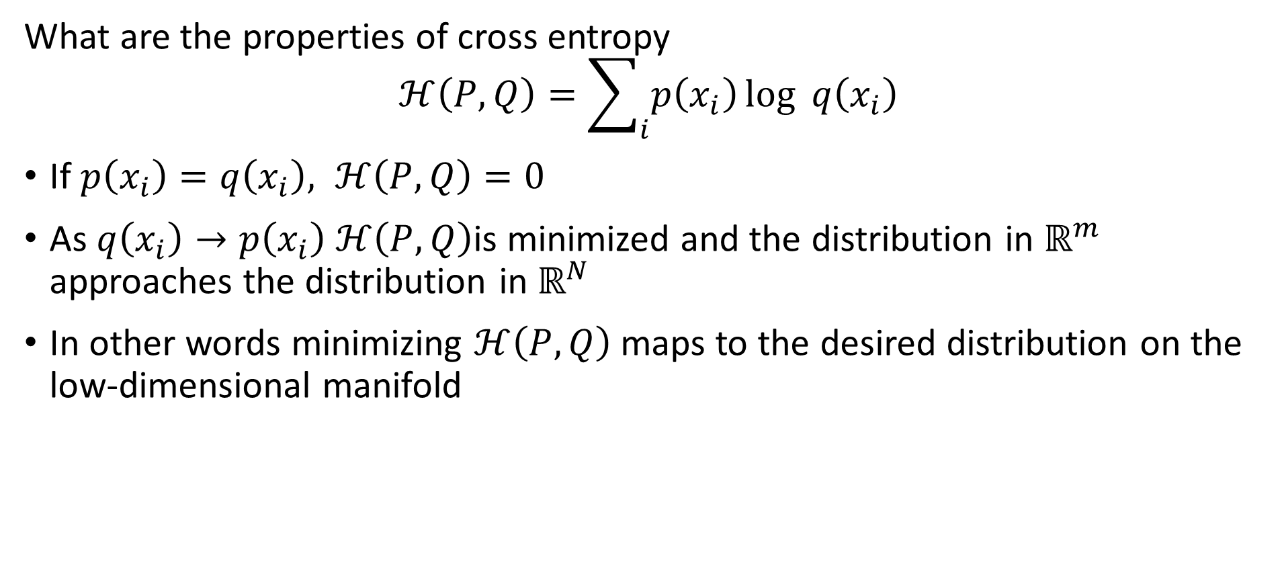
KL Divergence
What are the properties of cross entropy
$$ℋ\left(P,Q\right)=\sum_{i}{p\left(x_{i}\right)}\log{q\left(x_{i}\right)}$$
If $p\left(x_{i}\right)=q\left(x_{i}\right), ℋ\left(P,Q\right)=0$
As $q\left(x_{i}\right)→p\left(x_{i}\right) ℋ\left(P,Q\right)$is minimized and the distribution in $ℝ^{m}$ approaches the distribution in $ℝ^{N}$
In other words minimizing $ℋ\left(P,Q\right)$ maps to the desired distribution on the low-dimensional manifold

Slide 57
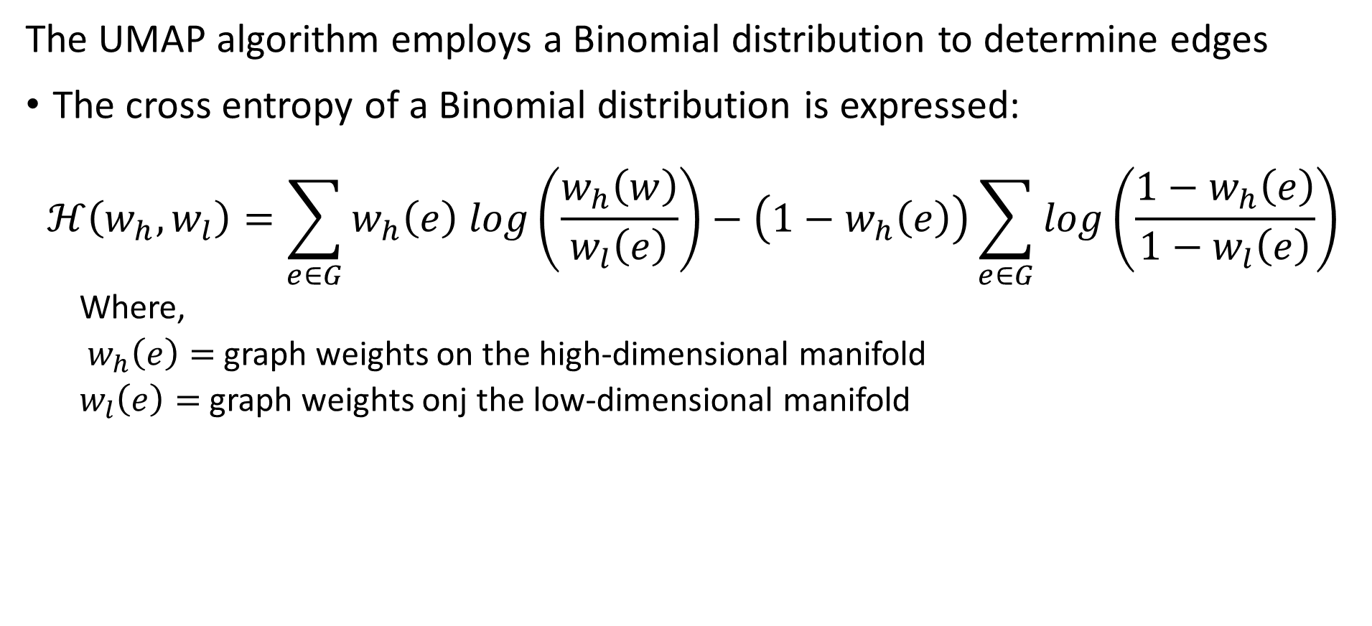
Uniform Manifold Approximation and Projection (UMAP)
The UMAP algorithm employs a Binomial distribution to determine edges
The cross entropy of a Binomial distribution is expressed:
$$ℋ\left(w_{h},w_{l}\right)=\sum_{e∈G}^{ }{w_{h}\left(e\right) log\left(\frac{w_{h}\left(w\right)}{w_{l}\left(e\right)}\right)−\left(1−w_{h}\left(e\right)\right)\sum_{e∈G}^{ }{log\left(\frac{1−w_{h}\left(e\right)}{1−w_{l}\left(e\right)}\right)}}$$
Where,
$w_{h}\left(e\right)=$ graph weights on the high-dimensional manifold
$w_{l}\left(e\right)=$ graph weights onj the low-dimensional manifold

Slide 58
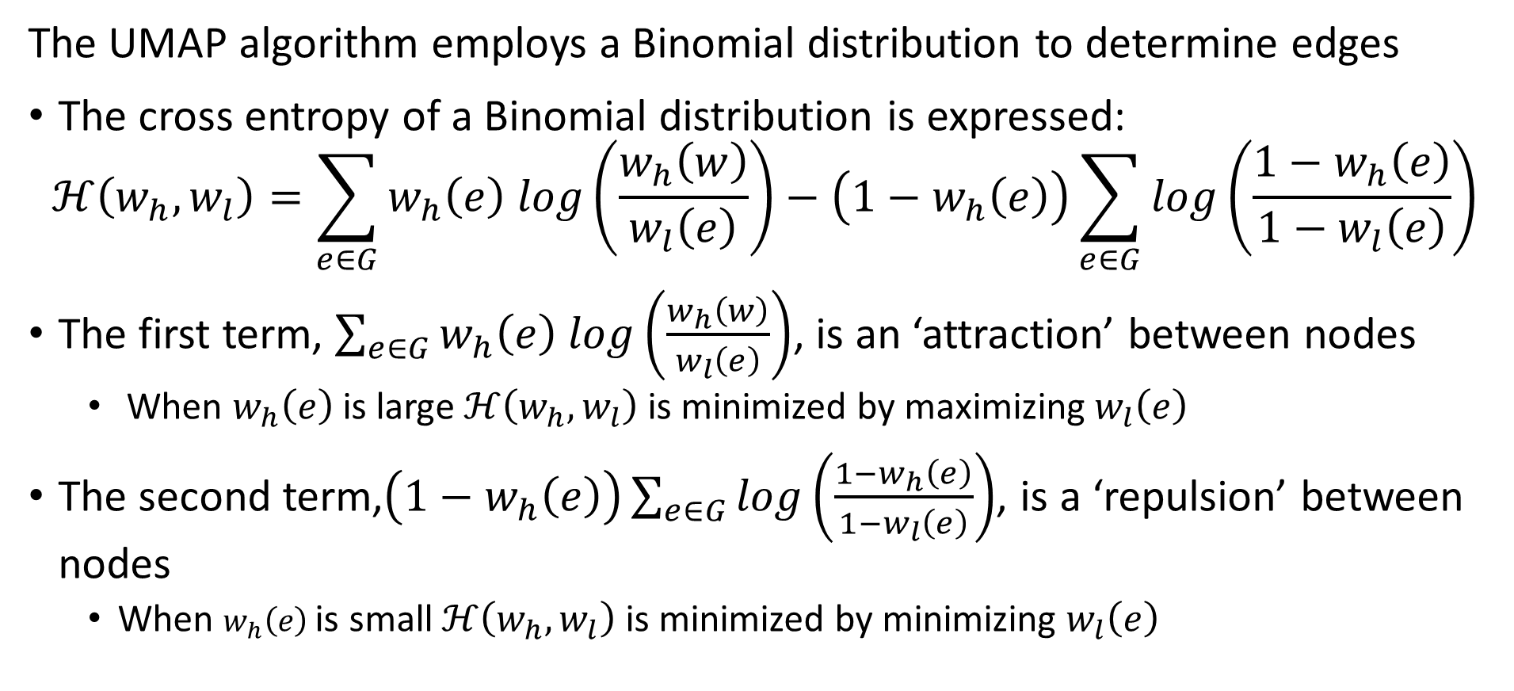
Uniform Manifold Approximation and Projection (UMAP)
The UMAP algorithm employs a Binomial distribution to determine edges
The cross entropy of a Binomial distribution is expressed:
$$ℋ\left(w_{h},w_{l}\right)=\sum_{e∈G}^{ }{w_{h}\left(e\right) log\left(\frac{w_{h}\left(w\right)}{w_{l}\left(e\right)}\right)−\left(1−w_{h}\left(e\right)\right)\sum_{e∈G}^{ }{log\left(\frac{1−w_{h}\left(e\right)}{1−w_{l}\left(e\right)}\right)}}$$
The first term, $\sum_{e∈G}^{ }{w_{h}\left(e\right) log\left(\frac{w_{h}\left(w\right)}{w_{l}\left(e\right)}\right)}$, is an ‘attraction’ between nodes
When $w_{h}\left(e\right)$is large $ℋ\left(w_{h},w_{l}\right)$ is minimized by maximizing $w_{l}\left(e\right)$
The second term,$\left(1−w_{h}\left(e\right)\right)\sum_{e∈G}^{ }{log\left(\frac{1−w_{h}\left(e\right)}{1−w_{l}\left(e\right)}\right)}$, is a ‘repulsion’ between nodes
When $w_{h}\left(e\right)$is small $ℋ\left(w_{h},w_{l}\right)$ is minimized by minimizing $w_{l}\left(e\right)$

Slide 59
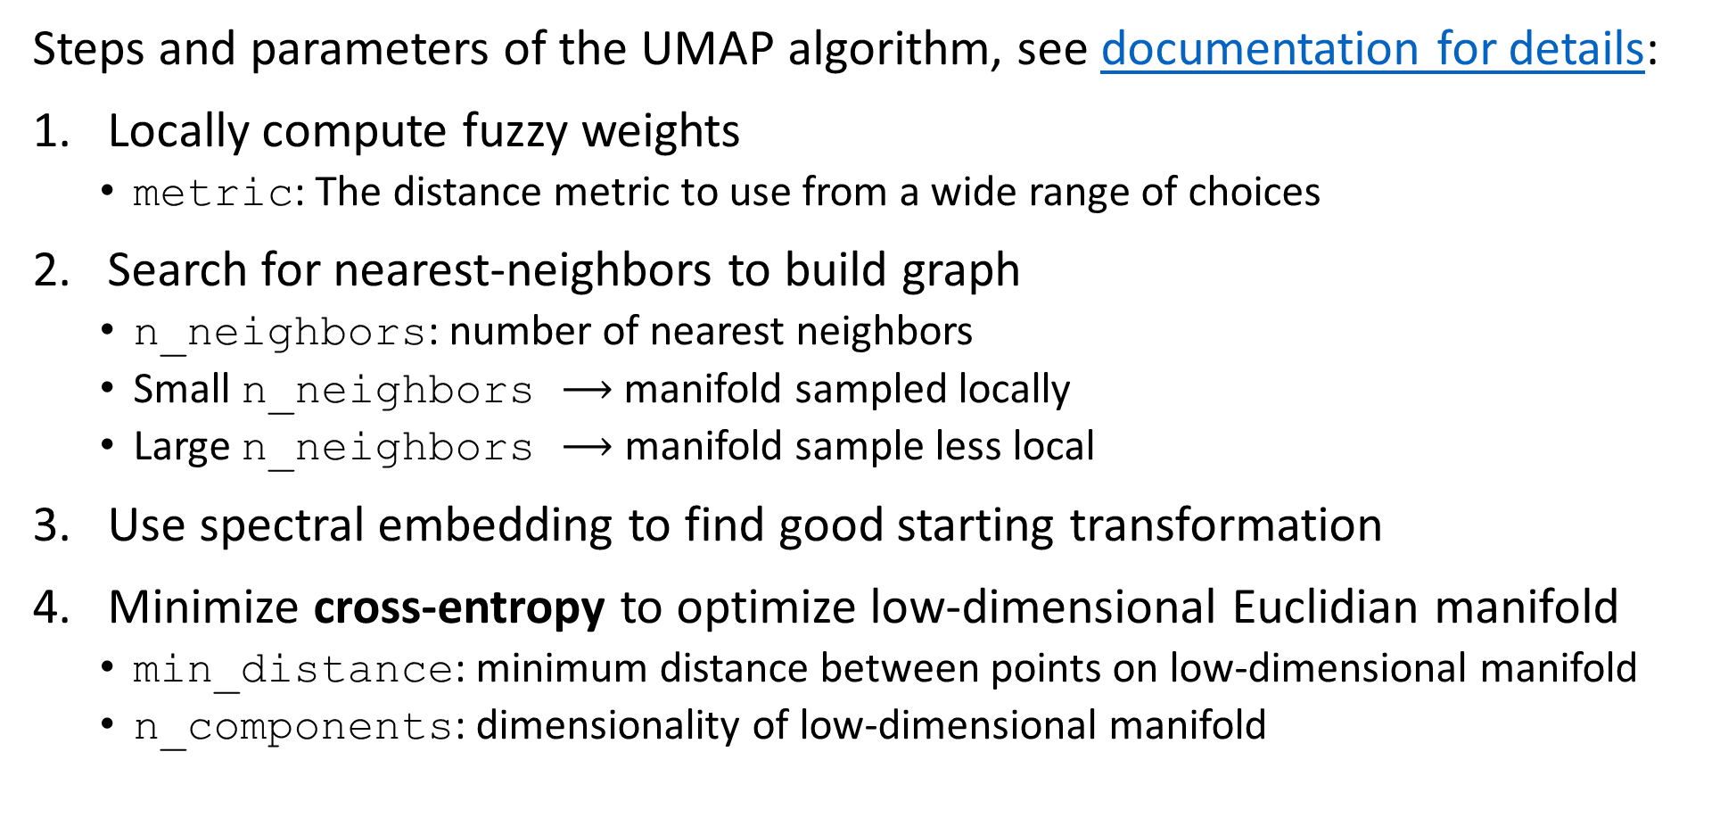
Uniform Manifold Approximation and Projection (UMAP)
Steps and parameters of the UMAP algorithm, see documentation for details:
Locally compute fuzzy weights
metric: The distance metric to use from a wide range of choices
Search for nearest-neighbors to build graph
n_neighbors: number of nearest neighbors
Small n_neighbors $⟶$ manifold sampled locally
Large n_neighbors $⟶$ manifold sample less local
Use spectral embedding to find good starting transformation
Minimize cross-entropy to optimize low-dimensional Euclidian manifold
min_distance: minimum distance between points on low-dimensional manifold
n_components: dimensionality of low-dimensional manifold

Slide 60
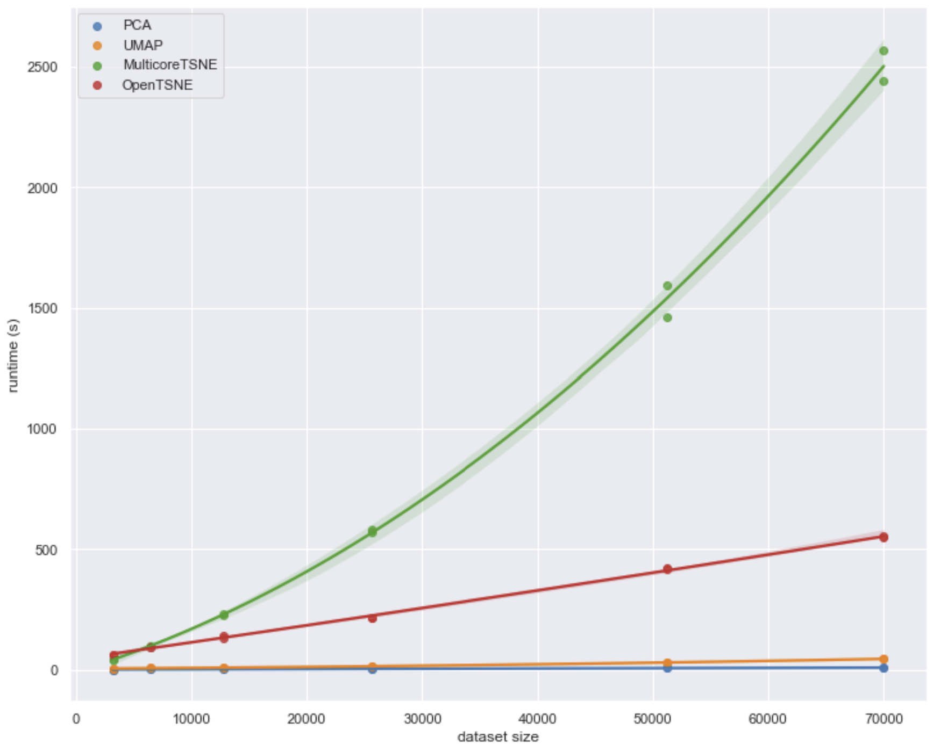
Uniform Manifold Approximation and Projection (UMAP)
How does UMAP performance compare?
From UMAP documentation, Leland McInnis, 2018

Slide 61
Summary
Dimensionality reduction is widely used in data mining
Review of high-dimensional spaces and the Curse of Dimensionality
Projection methods for high dimensions
Highly efficient alternative to PCA
Bounds on distance error
Manifold learning and visualization in high dimensions
Project to low dimensional manifold
Can be distance preserving

Slide 62
Appendix tSNE Algorithm

Slide 63
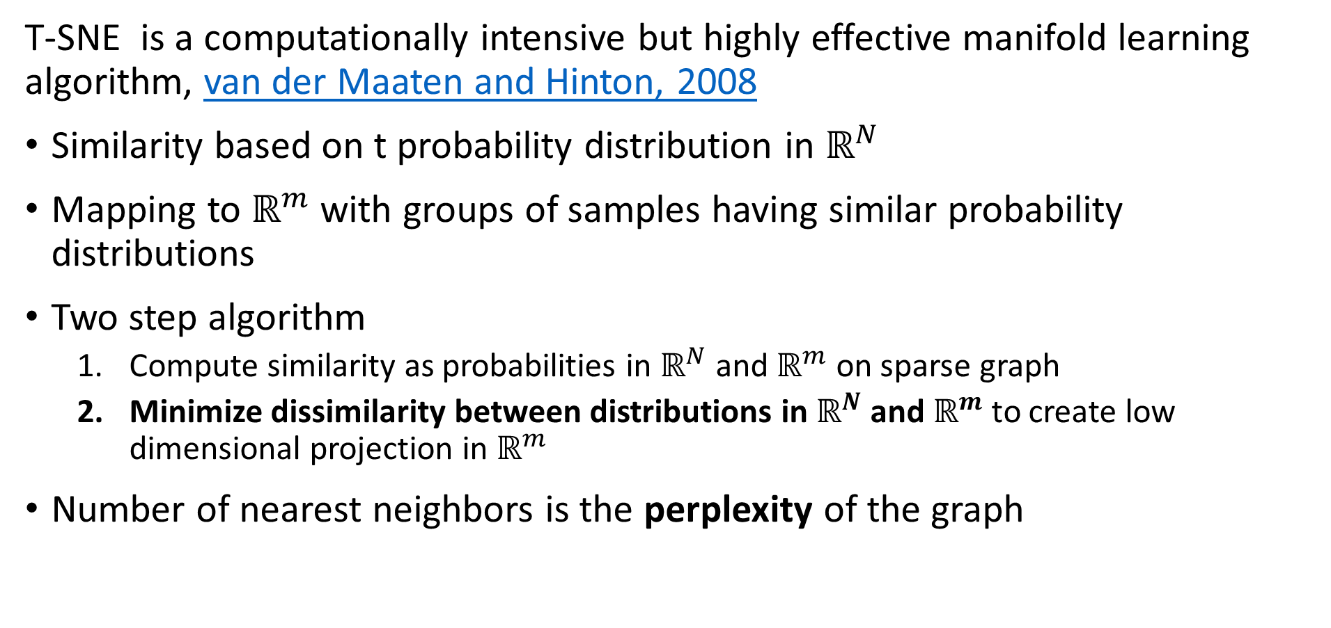
t-SNE
T-SNE is a computationally intensive but highly effective manifold learning algorithm, van der Maaten and Hinton, 2008
Similarity based on t probability distribution in $ℝ^{N}$
Mapping to $ℝ^{m}$ with groups of samples having similar probability distributions
Two step algorithm
Compute similarity as probabilities in $ℝ^{N}$ and $ℝ^{m}$ on sparse graph
Minimize dissimilarity between distributions in $ℝ^{N}$ and $ℝ^{m}$ to create low dimensional projection in $ℝ^{m}$
Number of nearest neighbors is the perplexity of the graph

Slide 64
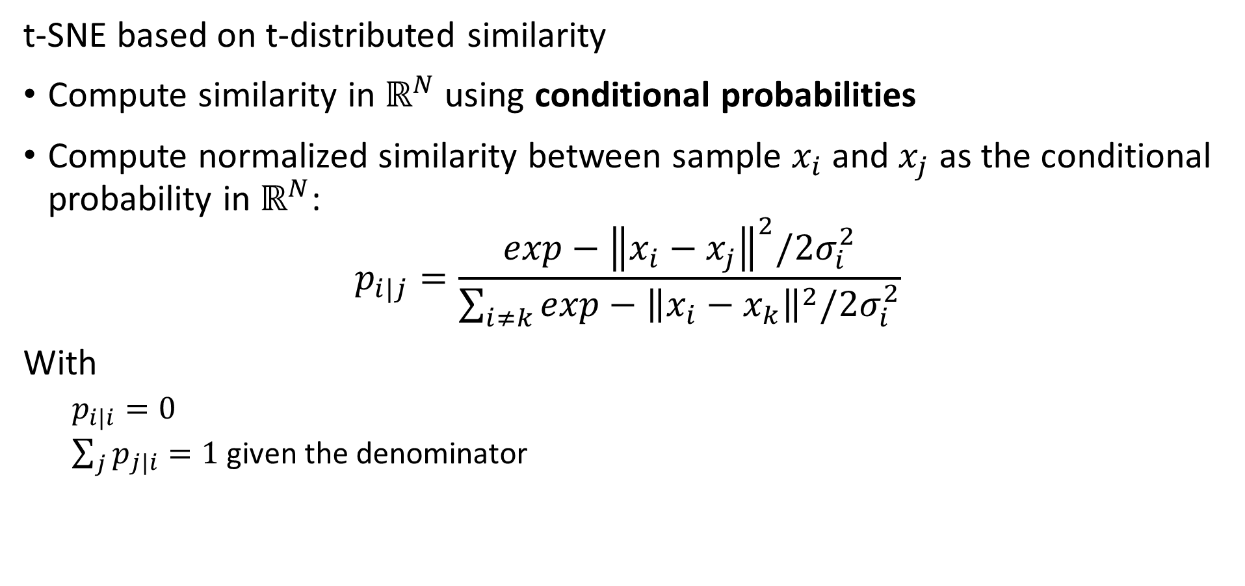
t-SNE
t-SNE based on t-distributed similarity
Compute similarity in $ℝ^{N}$ using conditional probabilities
Compute normalized similarity between sample $x_{i}$ and $x_{j}$ as the conditional probability in $ℝ^{N}$:
$$p_{i|j}=\frac{exp−{\left\|x_{i}−x_{j}\right\|}^{2}/2σ_{i}^{2}}{\sum_{i≠k}^{ }{exp−{\left\|x_{i}−x_{k}\right\|}^{2}/2σ_{i}^{2}}}$$
With
$p_{i|i}=0$
$\sum_{j}{p_{j|i}}=1$ given the denominator

Slide 65
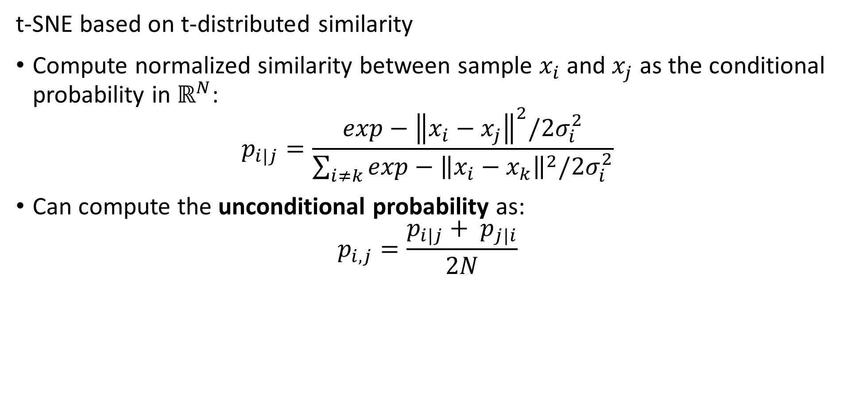
t-SNE
t-SNE based on t-distributed similarity
Compute normalized similarity between sample $x_{i}$ and $x_{j}$ as the conditional probability in $ℝ^{N}$:
$$p_{i|j}=\frac{exp−{\left\|x_{i}−x_{j}\right\|}^{2}/2σ_{i}^{2}}{\sum_{i≠k}^{ }{exp−{\left\|x_{i}−x_{k}\right\|}^{2}/2σ_{i}^{2}}}$$
Can compute the unconditional probability as:
$$p_{i,j}=\frac{p_{i|j}+ p_{j|i}}{2N}$$

Slide 66
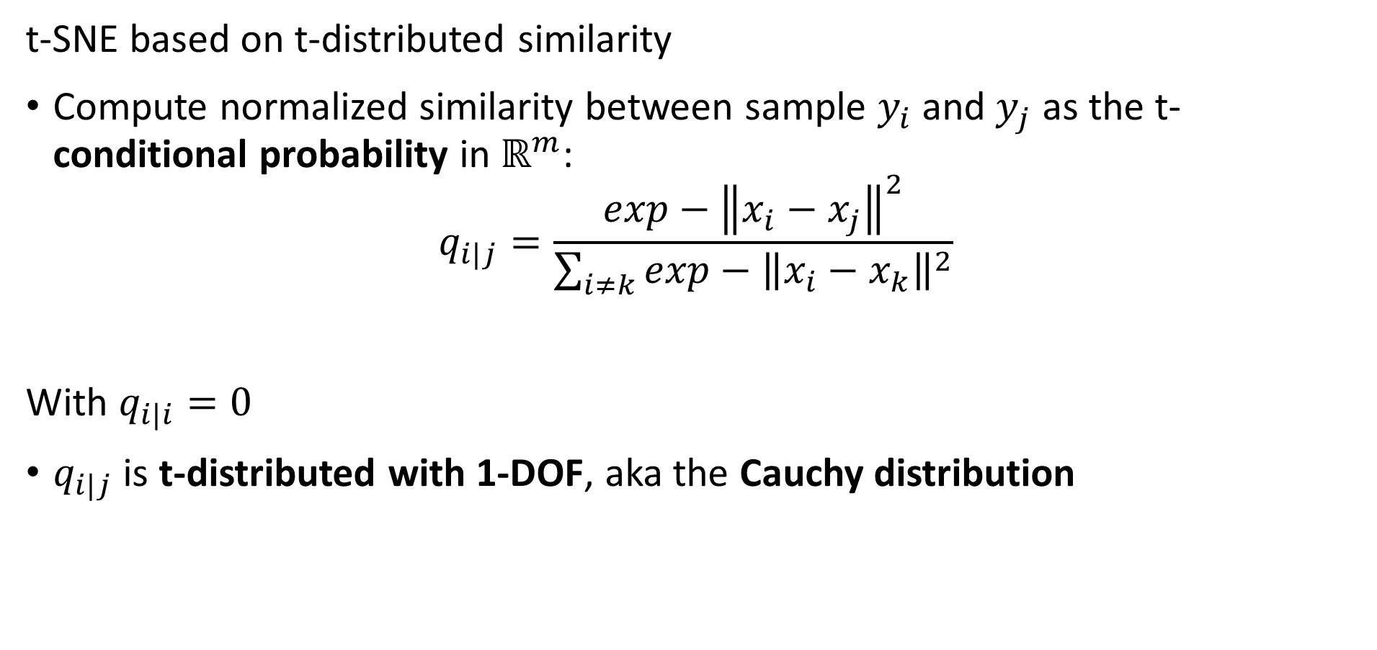
t-SNE
t-SNE based on t-distributed similarity
Compute normalized similarity between sample $y_{i}$ and $y_{j}$ as the t-conditional probability in $ℝ^{m}$:
$$q_{i|j}=\frac{exp−{\left\|x_{i}−x_{j}\right\|}^{2}}{\sum_{i≠k}^{ }{exp−{\left\|x_{i}−x_{k}\right\|}^{2}}}$$
With $q_{i|i}=0$
$q_{i|j}$ is t-distributed with 1-DOF, aka the Cauchy distribution

Slide 67
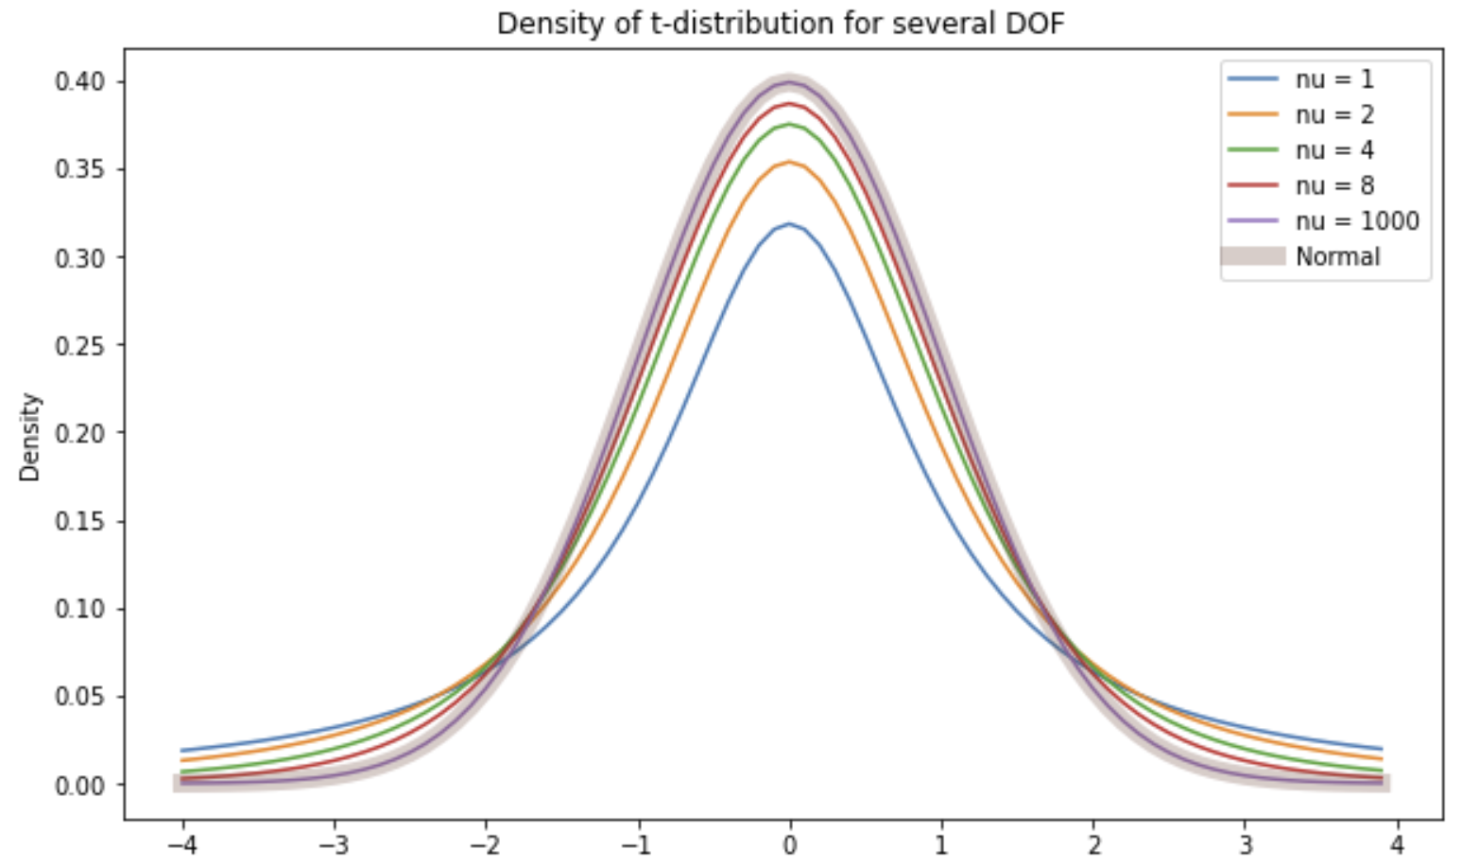
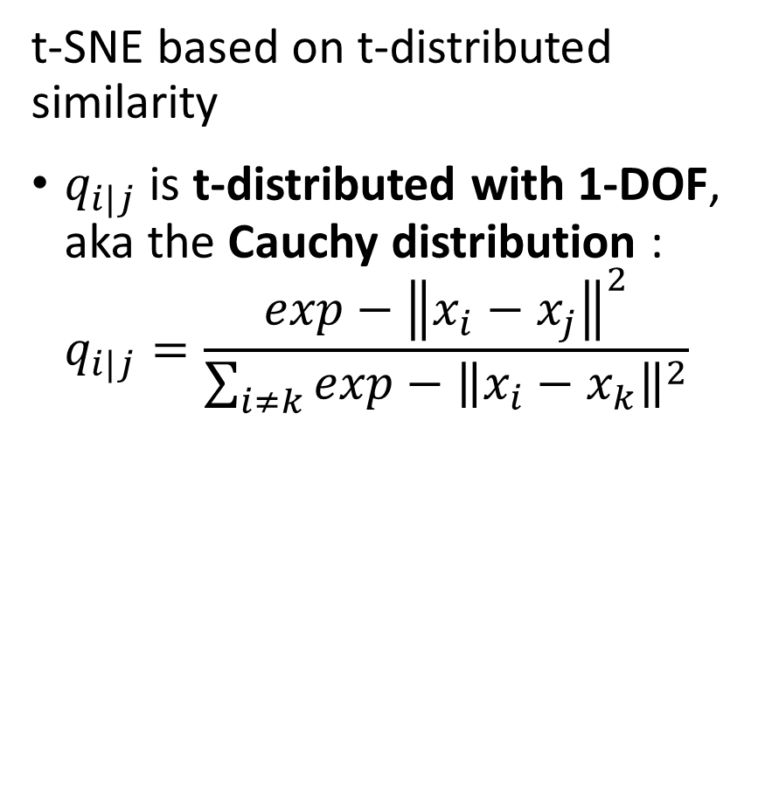
t-SNE
t-SNE based on t-distributed similarity
$q_{i|j}$ is t-distributed with 1-DOF, aka the Cauchy distribution :
$$q_{i|j}=\frac{exp−{\left\|x_{i}−x_{j}\right\|}^{2}}{\sum_{i≠k}^{ }{exp−{\left\|x_{i}−x_{k}\right\|}^{2}}}$$

Slide 68
t-SNE
t-SNE based on t-distributed similarity
Why is the t-distribution a good choice
Notice that for the Normal distribution probability low for samples far from the center
t-distribution has reasonable probability further from center
t-distribution with 1 DOF has heaviest tail

Slide 69
Uniform Manifold Approximation and Projection (UMAP)
How does the UMAP algorithm work?
Algorithm for mapping to low dimensional Euclidian space has 4 major steps:
Locally compute fuzzy weights
Search for nearest-neighbors to build graph
Use spectral embedding to find good starting transformation
Minimize cross-entropy to optimize low-dimensional Euclidian manifold

Slide 70
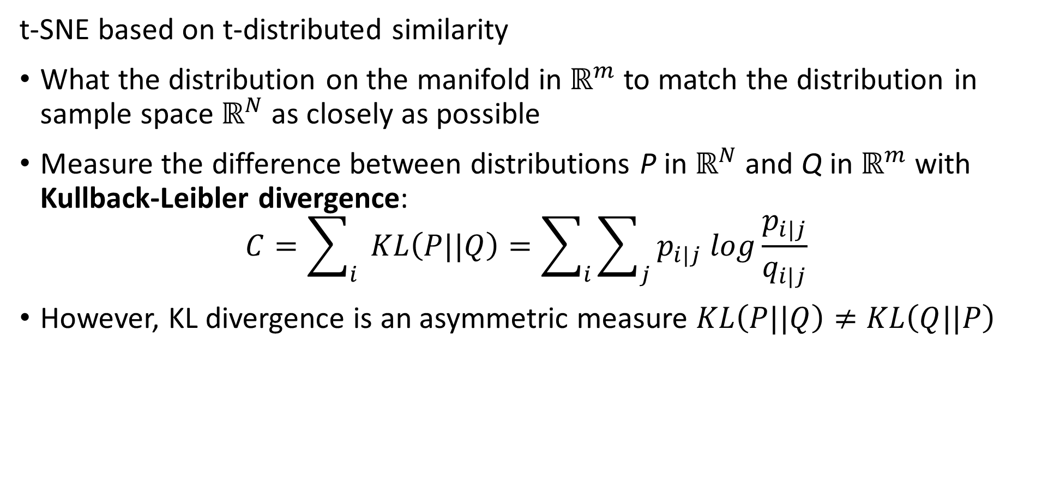
t-SNE
t-SNE based on t-distributed similarity
What the distribution on the manifold in $ℝ^{m}$ to match the distribution in sample space $ℝ^{N}$ as closely as possible
Measure the difference between distributions P in $ℝ^{N}$ and Q in $ℝ^{m}$ with Kullback-Leibler divergence:
$$C=\sum_{i}{ }KL\left(P||Q\right)=\sum_{i}{\sum_{j}{p_{i|j} log\frac{p_{i|j}}{q_{i|j}}}}$$
However, KL divergence is an asymmetric measure $KL\left(P||Q\right)≠KL\left(Q||P\right)$

Slide 71
T-SNE
The KL divergence is asymmetric
For two distributions the KL divergence depend on the order or arguments
Notice that the gradient becomes near zero on one side of the KL function

Slide 72

KL Divergence
KL divergence is based on Shannon Entropy
For information content of set of samples X, $I(X)$, the Shannon entropy $ℋ(X)$:
$$ℋ\left(X\right)=E\left[I(X)\right]$$
In terms of probabilities we can express Shannon entropy
$$ℋ\left(X\right)=E\left[{−log}_{b} P(X)\right]=\sum_{i}{P\left(x_{i}\right) \log_{b} P\left(x_{i}\right)}$$
What are some properties of Shannon entropy
The less predictable the outcome the higher the entropy
Example: if outcome is always the same $ℋ\left(X\right)=0$
Example: if outcome is completely random $ℋ\left(X\right)=maximum$

Slide 73
KL Divergence
Events with random outcome have maximum entropy, $\operatorname{Pr}\left(X=1\right)=0.5$
Understanding Shannon Entropy
Example: binomially distributed events
Events with known outcome have 0 entropy, $\operatorname{Pr}\left(X=1\right)=\{0 or 1\}$
Credit: Wikipedia commons

Slide 74
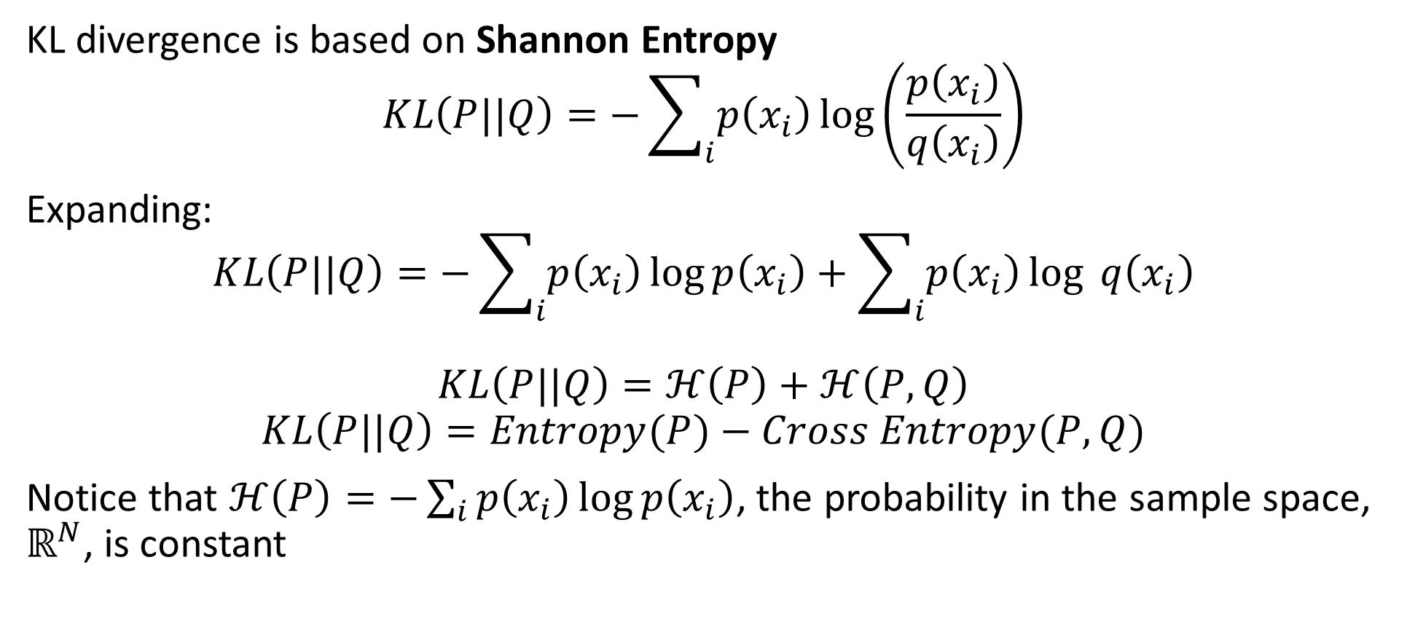
KL Divergence
KL divergence is based on Shannon Entropy
$$KL\left(P||Q\right)=−\sum_{i}{p\left(x_{i}\right)}\log\left(\frac{p\left(x_{i}\right)}{q\left(x_{i}\right)}\right)$$
Expanding:
$$KL\left(P||Q\right)=−\sum_{i}{p\left(x_{i}\right)}\log{p\left(x_{i}\right)}+\sum_{i}{p\left(x_{i}\right)}\log{q\left(x_{i}\right)}$$
$$KL\left(P||Q\right)=ℋ\left(P\right)+ℋ\left(P,Q\right)$$
$$KL\left(P||Q\right)=Entropy(P)−Cross Entropy(P,Q)$$
Notice that $ℋ\left(P\right)=−\sum_{i}{p\left(x_{i}\right)}\log{p\left(x_{i}\right)}$, the probability in the sample space, $ℝ^{N}$, is constant

Slide 75
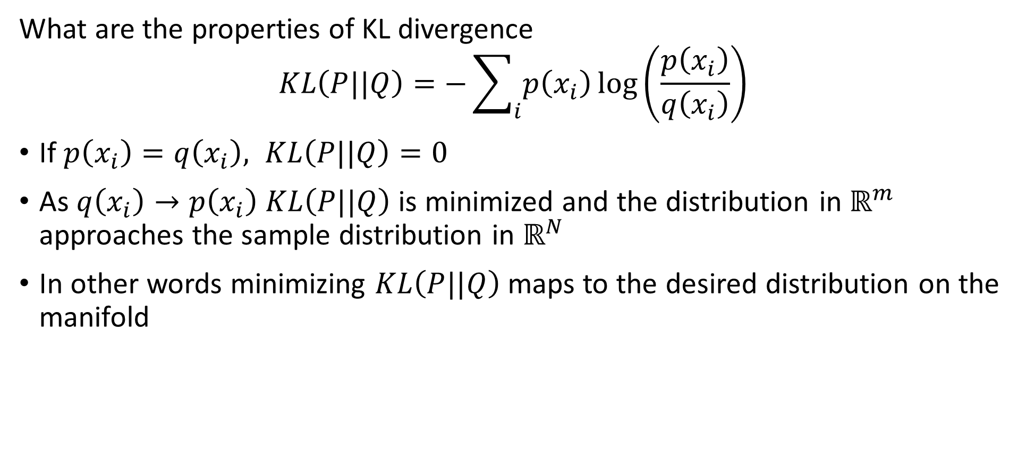
KL Divergence
What are the properties of KL divergence
$$KL\left(P||Q\right)=−\sum_{i}{p\left(x_{i}\right)}\log\left(\frac{p\left(x_{i}\right)}{q\left(x_{i}\right)}\right)$$
If $p\left(x_{i}\right)=q\left(x_{i}\right), KL\left(P||Q\right)=0$
As $q\left(x_{i}\right)→p\left(x_{i}\right)$ $KL\left(P||Q\right)$is minimized and the distribution in $ℝ^{m}$ approaches the sample distribution in $ℝ^{N}$
In other words minimizing $KL\left(P||Q\right)$ maps to the desired distribution on the manifold

Slide 76
Summary
Dimensionality reduction is widely used in data mining
Review of high-dimensional spaces and the Curse of Dimensionality
Projection methods for high dimensions
Highly efficient alternative to PCA
Bounds on distance error
Manifold learning and visualization in high dimensions
Project to low dimensional manifold
Not distance preserving

Slide 77
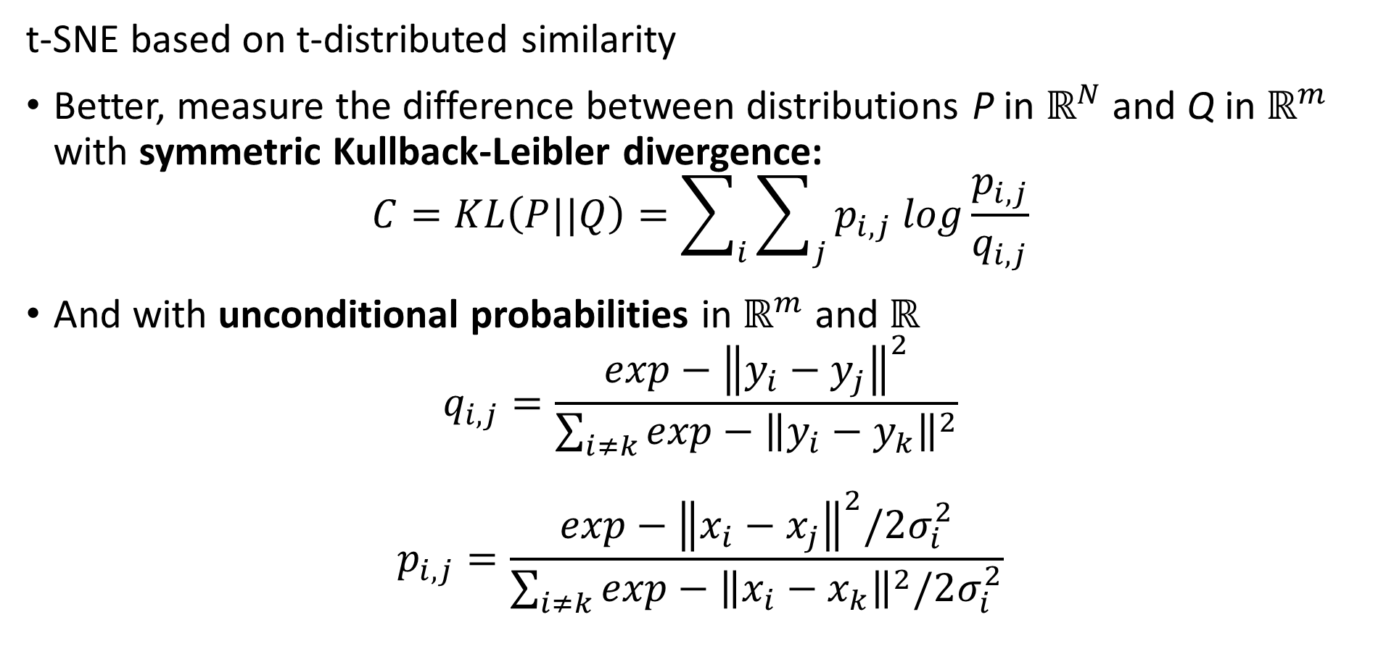
t-SNE
t-SNE based on t-distributed similarity
Better, measure the difference between distributions P in $ℝ^{N}$ and Q in $ℝ^{m}$ with symmetric Kullback-Leibler divergence:
$$C=KL\left(P||Q\right)=\sum_{i}{\sum_{j}{p_{i,j} log\frac{p_{i,j}}{q_{i,j}}}}$$
And with unconditional probabilities in $ℝ^{m}$ and $ℝ^{}$
$$q_{i,j}=\frac{exp−{\left\|y_{i}−y_{j}\right\|}^{2}}{\sum_{i≠k}^{ }{exp−{\left\|y_{i}−y_{k}\right\|}^{2}}}$$
$$p_{i,j}=\frac{exp−{\left\|x_{i}−x_{j}\right\|}^{2}/2σ_{i}^{2}}{\sum_{i≠k}^{ }{exp−{\left\|x_{i}−x_{k}\right\|}^{2}/2σ_{i}^{2}}}$$

Slide 78
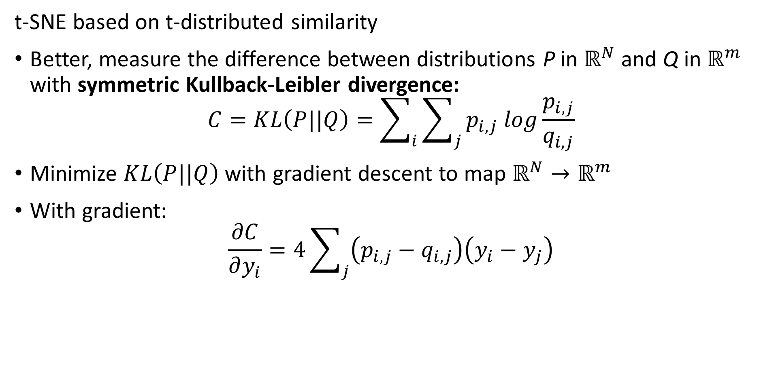
t-SNE
t-SNE based on t-distributed similarity
Better, measure the difference between distributions P in $ℝ^{N}$ and Q in $ℝ^{m}$ with symmetric Kullback-Leibler divergence:
$$C=KL\left(P||Q\right)=\sum_{i}{\sum_{j}{p_{i,j} log\frac{p_{i,j}}{q_{i,j}}}}$$
Minimize $KL\left(P||Q\right)$ with gradient descent to map $ℝ^{N}→ℝ^{m}$
With gradient:
$$\frac{∂C}{∂y_{i}}=4\sum_{j}{\left(p_{i,j}−q_{i,j}\right)\left(y_{i}−y_{j}\right)}$$

Slide 79
t-SNE
t-SNE based on t-distributed similarity
Better, measure the difference between distributions P in $ℝ^{N}$ and Q in $ℝ^{m}$ with symmetric Kullback-Leibler divergence:
$$C=KL\left(P||Q\right)=\sum_{i}{\sum_{j}{p_{i,j} log\frac{p_{i,j}}{q_{i,j}}}}$$
Minimize $KL\left(P||Q\right)$ with gradient descent to map $ℝ^{N}→ℝ^{m}$
With gradient:
$$\frac{∂C}{∂y_{i}}=4\sum_{j}{\left(p_{i,j}−q_{i,j}\right)\left(y_{i}−y_{j}\right)}$$

Slide 80
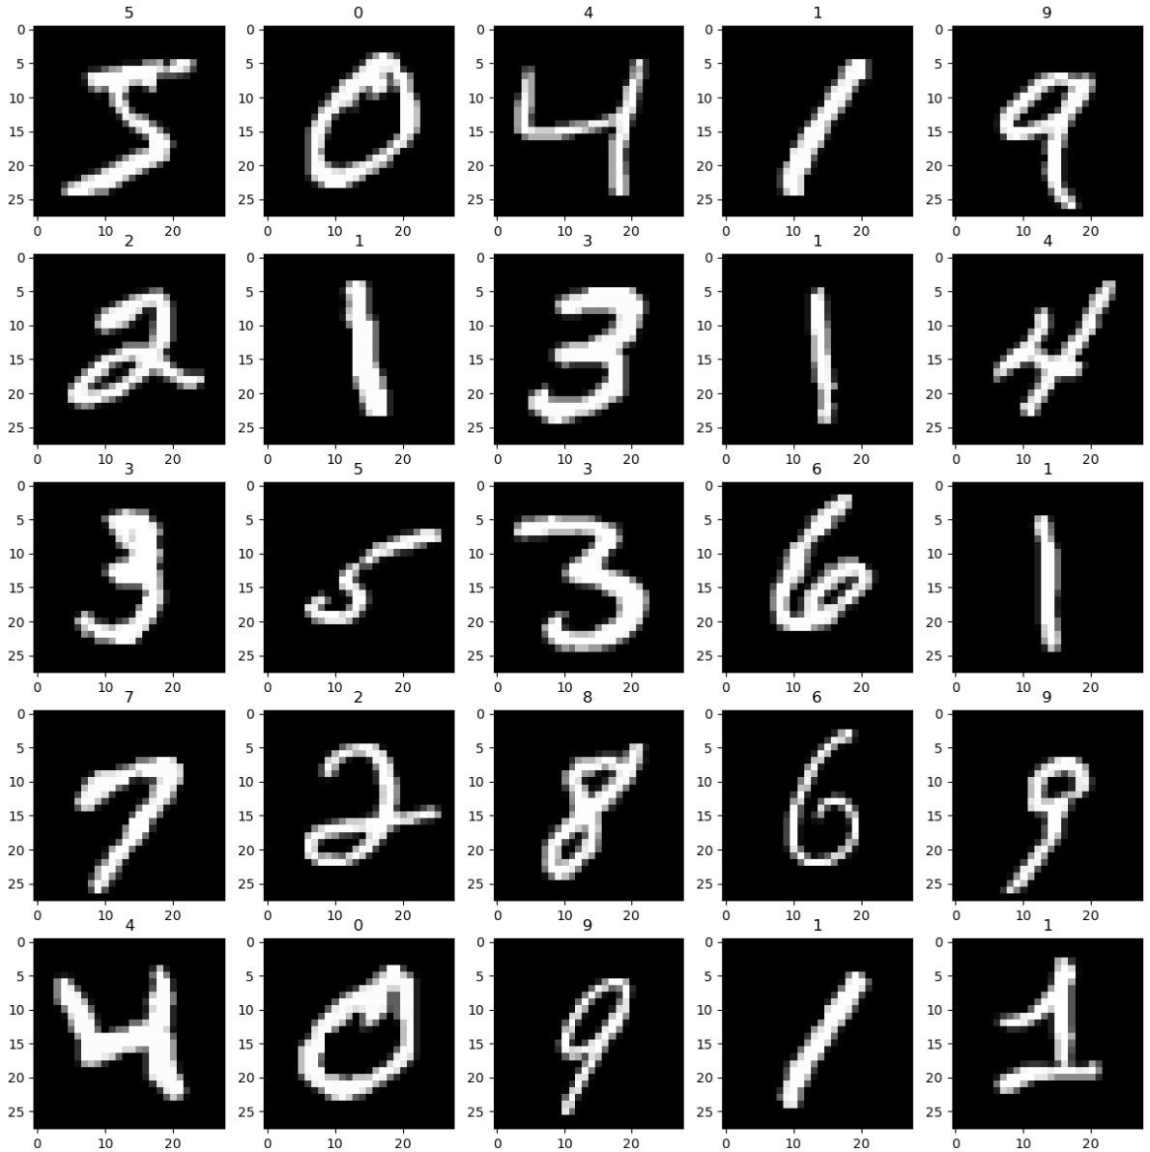
Example t-SNE vs. PCA
Use the pixel values of handwritten MNIST digits dataset

Slide 81
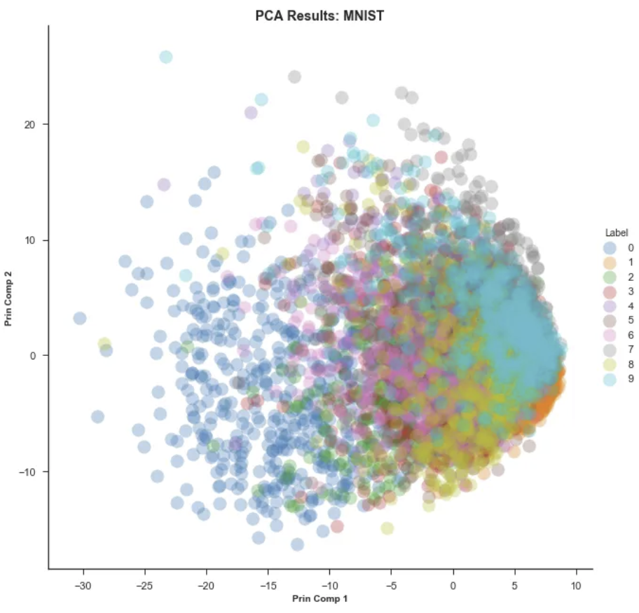
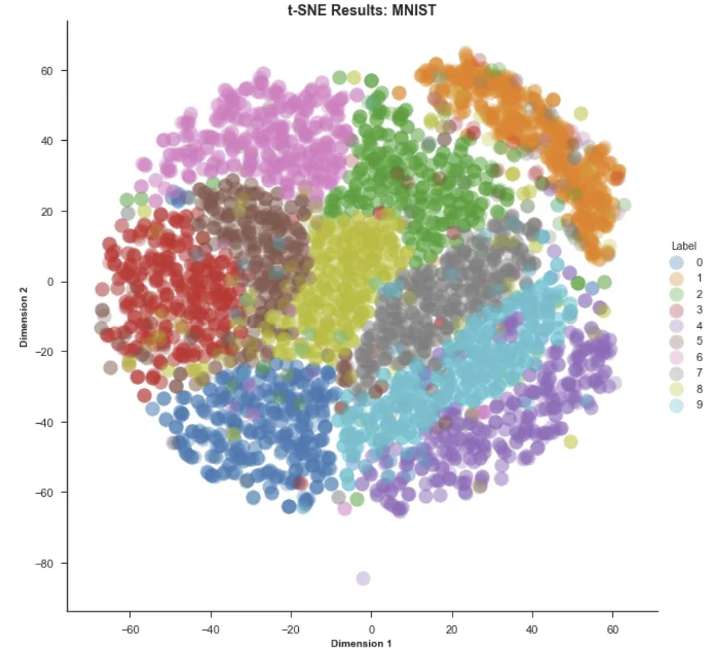
Example t-SNE vs. PCA
First 2 PCs, linear manifold
t-SNE, perplexity = 50
From blog post by Andrey Violante

